Slide 1
The long-term vision for rural areas & the Rural Pact
European Rural Pact Support Office
Version: September 2026
Notes:
Dear Rural Pact colleague,
This presentation provides with information about the long-term vision for EU’s rural areas (rural vision) and the Rural Pact.
You can use and modify these slides at your convenience as they aim to help you build an understanding, but also to prepare your presentations when introducing the rural vision and the Rural Pact.
Each slide has notes that provide further explanations of the content included.
We hope you find them useful!
The Rural Pact Support Office Team

Slide 2

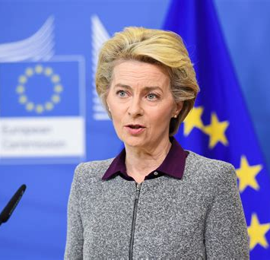
The long-term vision for EU’s rural areas
“
Rural areas are a formative part of the European economy and cultural diversity.
They are home to hundreds of millions of Europeans who enjoy living and working there. We stand by their side and want Europe's rural areas to flourish.
Europe is investing in rural areas because their prospects are Europe's future.
European Commission President Ursula von der Leyen
27 March 2024
Notes:
The President of the Commission took the opportunity of the publication of the report on the achievements and ways forward of the LTVRA to reiterate her support to rural areas.
She stressed that Europe is investing in them because their prospects are Europe’s future.
And this reflects well the focus on the importance of rural areas that we have managed to achieve since the adoption of the rural vision.

Slide 3

In this presentation, you can read about…
The long-term vision for EU’s rural areas
The Rural Pact and its Support Office
Rural Pact activities and online Community Platform tools
The way forward to the post-2027 rural policy framework

Slide 4

The long-term vision for EU’s rural areas

Slide 5

The long-term vision for EU’s rural areas - Towards stronger, connected, resilient and prosperous rural areas by 2040
The start of the rural vision 2040
European Commission Communication
A long-term vision for the EU’s rural areas - Towards stronger, connected, resilient and prosperous rural areas by 2040 (June 2021)
European Commission 2019-2024 term
Involved Commissioners
Dubravka Šuica, EC Vice-president, Demography & Democracy
Janusz Wojciechowski, Agriculture
Elisa Ferreira, Cohesion and reforms
European Commission Communication: A long-term vision for the EU’s rural areas - Towards stronger, connected, resilient and prosperous rural areas by 2040 (June 2021)
Notes:
The EU launched a reflection with all actors across Europe to draw the common ambitions to achieve for rural areas. This process was coordinated by three Commissioners of the 2019-2024 term of office: the Vice-President Šuica (Democracy and demography), with Commissioners Wojciechowski (Agriculture) and Ferreira (Cohesion and reforms) as lead and co-lead.
The process resulted in the publication of the European Commission Communication on the long-term vision for EU's rural areas in 2021, https://eur-lex.europa.eu/legal-content/EN/TXT/?uri=CELEX%3A52021DC0345 .
Since the adoption, there has been constructive dialogue with EU institutions and bodies.
The Communication triggered political reactions from the Council of the EU, the European Parliament, the Committee of the Regions, the Economic and Social Committee who reacted positively to the Communication.

Slide 6
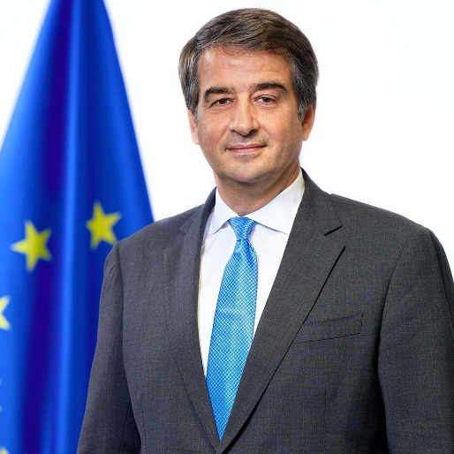
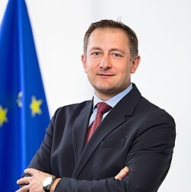
The long-term vision for EU’s rural areas - towards stronger, connected, resilient and prosperous rural areas by 2040
The rural vision now
European Commission 2024-2029 term
Executive Vice-President Cohesion & reforms
Raffaele Fitto
Commissioner
Agriculture & Food
Christophe Hansen
European Commission Communication: A long-term vision for the EU’s rural areas - Towards stronger, connected, resilient and prosperous rural areas by 2040 (June 2021)
Notes:
For the 2024-2029 term of the European Commission’s college of Commissioners, the long-term vision for EU’s rural areas falls under the portfolio of two Commissioners:
Raffaele Fitto: Executive Vice-President for Cohesion and Reforms
Christophe Hansen: Commissioner for Agriculture and Food

Slide 7


A new vision for agriculture and food, support for rural areas (Feb 2025)
Working in synergy with the rural vision 2040
Four priority areas
Actions for vibrant and well-connected rural areas
Enhance synergies and complementarities
EU Rural Action Plan update in 2026
Strengthen the Rural Pact
Further operationalise the rural proofing principle
Strengthen participatory, local development tools, such as LEADER/CLLD and Smart Villages
Further develop the concept of functional rural areas
Address the targeted spread of disinformation in rural areas
Attractive agri-food sector
Competitive and resilient sector
Future-proof sector
Vibrant & well-connected rural areas
Commissioner
Agriculture & Food
Christophe Hansen
https://agriculture.ec.europa.eu/overview-vision-agriculture-food/vision-agriculture-and-food_en
Notes:
A new Vision for Agriculture and Food was adopted by the European Commission in February 2025. This vision complements the long-term vision for EU’s rural areas (launched in 2021) by setting out specific actions for vibrant and well-connected rural areas.
The vision represents a roadmap for the future of farming and food in the European Union.
(For more detail on the Vision for Agriculture and Food, see slides 37-38.)

Slide 8
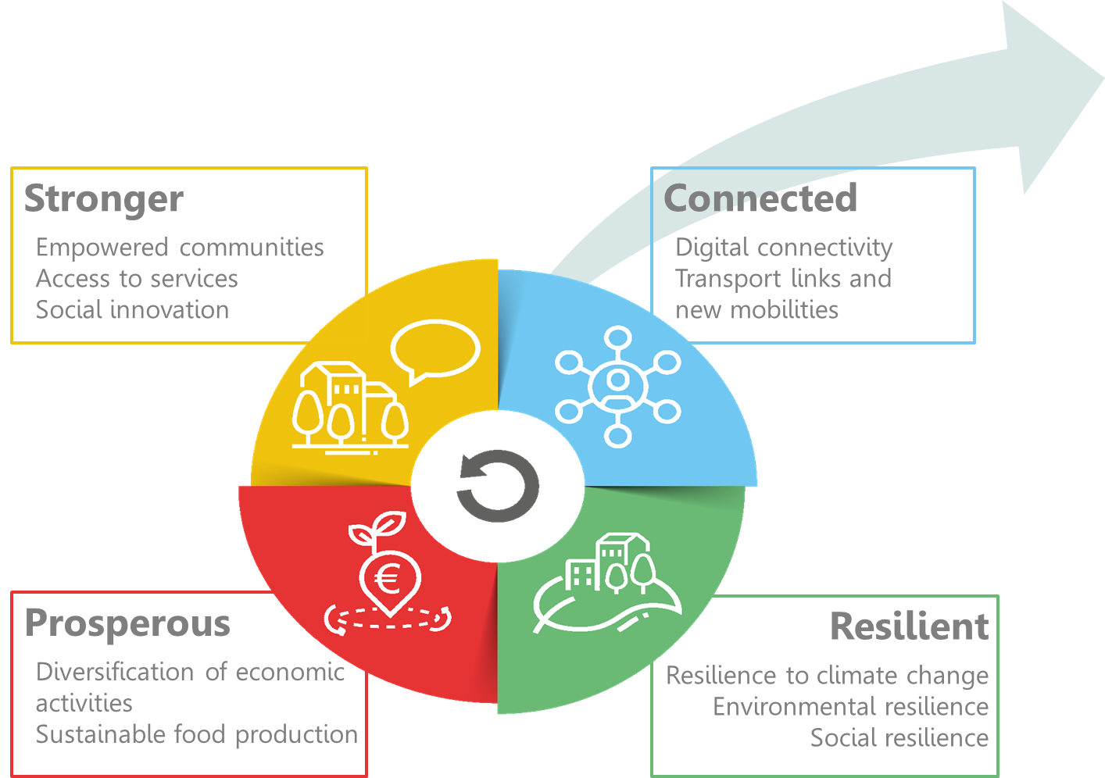

The long-term vision for the EU’s rural areas
Shared goals for 2040
Rural Action Plan (EC)
&
Rural Pact (everyone)
Notes:
Meanwhile, the EU rural vision 2040 continues to support rural regions through:
The Rural Action Plan – actions that the European Commission has been implementing since 2021 (see slide 11); an update of the plan is expected in 2026.
The Rural Pact – a stakeholder collaboration (see slides 16 to 22).
The European Commission’s rural vision prepares the ground for future action, but does not bring new funds. For now, stakeholders have to use existing policies and funds, as they have been agreed by the European Parliament and Member States in the Council, before the adoption of the rural vision.
The rural vision brought together the common aspirations of Europeans on how they would like rural areas to be in the future: stronger, connected, resilient and prosperous.

Slide 9








Interinstitutional dialogue
Relevant Council Presidencies
Jan - Jun 2022
Jul - Dec 2022
Jan - Jun 2023
Jul - Dec 2023
Jul - Dec 2024
Jan - Jun 2025
Jul - Dec 2026
French Presidency GAC Cohesion conclusions on Cohesion report
(2 Jun 2022)
Czech Presidency Lednice declaration + launch of CZ Rural Pact
(28 Oct 2022)
Swedish Presidency Rural pact Conference in Sweden
(3-4 May 2023)
Spanish Presidency High-level rural policy forum (27-29 Sep 2023, Sigüenza)
Council conclusions (20 Nov 2023)
Hungarian Presidency Council Conclusions
(9 December 2024)
Polish Presidency Rural proofing
(24 February 2025)
Irish Presidency High-level policy forum: Europe’s rural future (3-4 Nov 2026, Naas, County Kildare)
Notes:
The work on the rural vision and the Rural Pact are contributing to bring issues higher on the political agenda including through dialogue between various European institutions and bodies.
This was prepared through several steps:
The Slovenian presidency held an informal Council debate in autumn 2021.
The French presidency adopted conclusions on the 8th Cohesion report that include a reference to the rural vision.
The Czech presidency launched its national Rural Pact, leading by example and participated in the declaration of Lednice that brings together also the Committee of the regions and the European Parliament.
In May 2023, the Swedish presidency hosted the Rural Pact conference in Uppsala to share best practices and examples on the implementation of the Rural Pact at national level, discuss the multi-level governance for holistic rural development, explore tools and methods for the Rural Pact and examine young people’s involvement and participation in the Rural Pact.
In September 2023, the Spanish presidency of the Council organised a High-level rural policy forum that had the ambition to prepare the ground for Council conclusions dedicated to the rural vision.
The Council of the European Union, under the Spanish presidency, adopted conclusions on the Vision on the 20th November 2023 during the AGRIFISH Council: https://www.consilium.europa.eu/en/press/press-releases/2023/11/20/a-long-term-vision-for-the-eu-s-rural-areas-council-approves-conclusions/
The highlights of the Nov 2023 Council include:
call on the European Commission to consider developing the vision into an EU rural strategy
encouragement to Member States to further engage in the Rural Pact and develop strategies and actions plans at national, regional and local levels
rural areas as key contributors to the EU's economies and societies
the need for a holistic approach to address multifaceted challenges
the need to make sure rural voices are heard
the importance of better connectivity and digital skills
the importance of investments from EU, national, regional and local sources
Subsequent EU Council Presidencies emphasised specific aspects of rural development policy:
Hungarian Council Conclusions (December 2024): farmer-focused future CAP with rural development maintaining a strong role in the architecture of the CAP
Polish Presidency note (February 2025): focus on improving the implementation of the rural proofing mechanism and better integrating rural development into EU policies
Irish Presidency (July-December 2026): promotes a continued policy focus and funding support for rural communities and rural development, alongside place-based approaches and balanced territorial development. In November 2026, it co-organises with the European Commission a High-level Rural Policy Forum on integrated national and regional rural strategies and LEADER/CLLD, including their role in the future National and Regional Partnership Plans (NRPPs).

Slide 10



Interinstitutional dialogue
European Parliament, Committee of the Regions and Economic and Social Committee
Opinion LTVRA (26 Jan 2022)
Opinion Smart Rural Europe (15 Mar 2023)
Opinion LEADER/CLLD and LTVRA (18 Feb 2025)
Opinion Future of the Rural Development 2028+ (6-7 May 2026)
Opinion LTVRA (23 Mar 2022)
Opinion Energy (13 Dec 2023)
Opinion Youth (14 Dec 2023)
Opinion LTVRA implementation (24 Apr 2024)
Opinion Circular economy (23 Oct 2024)
Opinion Post-2027 cohesion policy (27 Feb 2024)
Opinion MFF 2028-2034 (21 January 2026)
Opinion Rural proofing (23 September 2026)
Report (13 December 2022)
Notes:
The work on the rural vision and the Rural Pact are contributing to bring issues higher on the political agenda including through dialogue between various European institutions and bodies.
The Committee of the Regions (CoR), the European Economic and Social Committee (EESC) and the European Parliament all adopted opinions in 2022, following the Commission Communication in 2021.
Other relevant opinions on the EU rural vision or specific sub-topics have been issued since.

Slide 11
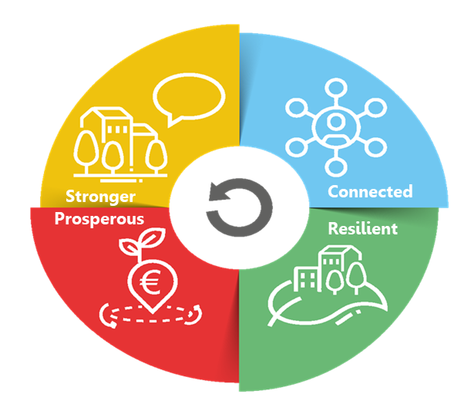
The rural action plan
10 SHARED GOALS FOR 2040
Attractive spaces, developed in harmonious territorial development
Engaged in multi-level and place-based governance
Providers of food security, economic opportunities, goods and services for wider society
Dynamic communities focusing on well-being
Inclusive communities
Flourishing sources of nature
Fully benefiting from digital innovation
Entrepreneurial, innovative and skilled people
Lively places equipped with efficient, accessible and affordable public and private services
Places of diversity
Notes:
The rural vision set 10 shared goals to be achieved by 2040 and cover a wide variety of thematic areas.
The vision exemplifies the need to think strategically about rural areas in an integrated way to be able to respond to the needs and opportunities of rural areas.
The vision aims to address the ambitions, needs and demands from all citizens. It includes farmers and their families, other businesses and people working in rural areas (many not involved in the agri-food and forestry sectors), as well as cities and towns that find mutual benefits with rural areas.
To achieve all the goals of the vision, it is absolutely necessary to broaden the range of stakeholders involved in rural development, including public authorities and policy makers, civil society involvement, academia, citizens and businesses.

Slide 12




The rural action plan: flagship initiatives
EU RURAL ACTION PLAN
9 Flagship initiatives
Rural revitalisation platform
Research and innovation for rural communities
Sustainable multimodal mobility best practices for rural areas
Rural digital futures
Support rural municipalities in energy transition and fighting climate change
Climate action in peatland through carbon farming
EU mission: a soil deal for Europe
Social resilience and women in rural areas
Entrepreneurship and social economy in rural areas
Connected
Notes:
The rural action plan contains 30 actions: 24 thematic actions and 6 horizontal actions to support implementation and improve governance.
The thematic actions are structured around the four blocks of action of the vision. They include:
9 flagships: these are bigger initiatives or groups of initiatives.
And 15 accompanying actions: these are more specific things, such as organising networking for LEADER and smart villages, or conducting specific studies.
The big novelty is that these actions involve 14 different Commission departments (like ministries) and the Commission organises coordination between them.
The rural action plan sets out actions that the European Commission commits to undertake itself. It is not a list of demands or instructions addressed to Member States. Rather, it outlines how the Commission intends to contribute to achieving the objectives of the rural vision and can serve as an example or inspiration for other actors wishing to support rural development.

Slide 13


The rural action plan: 24 thematic actions
Rural revitalisation platform launched
Networking on mobility for rural communities under SMARTA-NET
Rural energy communities advisory hub (RECAH)
  27 municipalities received technical assistance
  Guidance for all
Entrepreneurship and social economy (SE)
  Providing good practices for social economy in rural areas under “Transition pathway for proximity and social economy”
  Funding for consortia in SE in rural areas
Research and innovation for rural communities
  60 multi-actor research projects under Horizon EU
  European Start-up village forum launched
Urban mobility plans being updated with more focus on rural-urban linkages
Certification of Carbon removals
Rural Digital Futures
  €23.5 billion invested in connectivity in market failure areas
  Pilot on digital education in remote areas “Learning from the extremes”
Networking for LEADER (EU CAP Network) and Smart villages (SmartRural 21 & 27)
EU mission: A soil deal for Europe (R&I calls)
Funding for local/regional living labs and lighthouses
Education for youth
  Dedicated content for rural schools under school education platform & online teacher community
Study on land-use for sustainable agriculture working on recommendations for local planning and zoning
Broadband competency office network acting for improved connectivity in market failure areas
Capacity building/+advice
Social resilience and Women in rural areas
  Raising awareness on the importance of care in rural areas (European care strategy 2022)
Toolkit for producer groups in Geographical Indications
Youth:
  Getting more rural young people in ERASMUS
Networking for forest-dominant municipalities
Notes:
This slide presents some of the key achievements under the EU Rural action plan between 2021 and 2024.
All actions are ongoing or completed, some even continuing after what had been initially planned has been done.
This slides shows the wide variety of themes that are covered by the rural vision and the involvement of 14 Commission departments.
Even if the rural vision did not come with new funds, a substantial amount of money coming from EU funded programmes has been targeted to rural areas, like for example:
- research and innovation (253 million for over 60 projects).
- the flagging of €23.5 billion to improve connectivity, mostly in areas where markets fail to deliver (i.e. rural areas).
- technical assistance provided to support networking activities for LEADER and smart villages, creating energy communities, a mobility network or social economy consortia in rural areas.
- technical assistance to conduct studies or assemble working groups on rural youth, or working conditions of farm employees, or forestry, and improve our understanding of what is happening in rural areas.
Some of these actions are more geared to creating opportunities for rural citizens, like making sure their needs are taken care of in revised urban mobility plans or inviting Member States to act in their areas of competence such as care or digital skills, through Council recommendations.
The Commission report on the rural vision (March 2024) and the rural vision website provide more information on each of the actions.
As announced in the new Vision on Agriculture and Food, the Commission will launch in 2026 an updated EU Rural Action Plan that will be consolidated with projects, initiatives and actions from numerous policies of the EU to respond to the new European policy priorities post-2027.

Slide 14
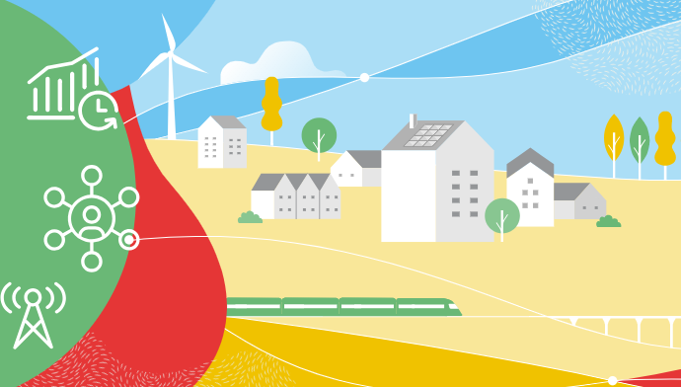
The rural action plan: horizontal actions
EU RURAL ACTION PLAN
6 Horizontal actions
The EU Rural Observatory (more)
Improved Statistics on rural areas
Functional Rural Areas
Rural Proofing at EU level
Rural toolkit on EU funding (more)
Rural Pact
Notes:
Similarly, all Horizontal actions are also launched.
1. (First action: the EU Rural Observatory)
First, the Rural Observatory which is coordinated by the Joint Research Centre (JRC) of the European Commission. It was set up with one clear ambition: give everyone access to essential data about rural areas to foster a better understanding of their circumstances and diversities, hence increasing the analytical capacities for evidence-based policies. A hundred indicators from multiple sources are included, covering economic, social and environmental dimensions at different levels of granularity. Please, browse through it if you have not done so yet.
Website: https://observatory.rural-vision.europa.eu/?lng=en&ctx=RUROBS
2. (Second action: Statistics on rural areas)
Before making them accessible in a centralised platform, data needs to be collected. To understand the complexity of the issues at stake more and better-quality data on rural areas are needed. This is why the European Commission has launched a second action, working with the statistics departments of Member States on improving statistics on rural areas. A new regulation is being discussed on population statistics, and experimental datasets on healthcare and education facilities have been published. All this to make the Rural Observatory even more comprehensive.
3. (Third action: definition of functional rural areas)
A third action is the application of the Functional Areas concept to the rural environment. Functional Areas seek to go beyond administrative boundaries through a better understanding of population and service flows, among other things. A first methodology of Functional Rural Areas has already been prepared by the Commission’s Joint Research Centre and DG REGIO. Meanwhile, the Commission, and the World Bank are working on a pilot project on Functional Areas, combining cities, towns and suburbs as well as rural areas. Indeed, the rural-urban space is understood as an interlinked continuum.
4. (Fourth action: rural proofing at EU level)
The European Commission are promoting the mainstreaming of rural areas concerns and issues — hence our fourth action, rural proofing. It is about taking a rural lens to new policy making. In November 2021, the European Commission updated the guidelines that all Commission services use to build new initiatives. Services are encouraged to explore whether initiatives will have differential impacts on territories, and if so, ensure mitigation measures. For legislatives initiatives, Territorial Impact Assessment is the procedure in place. The European Commission has also run a thematic group on rural proofing at national and regional levels, so to get to rural-proof national legislation too.
5. (Fifth action: toolkit on EU funding)
The European Commission has developed a toolkit oriented to practitioners on how to make full use and combine the various EU funds to support rural projects, beyond CAP and Cohesion Policy. The toolkit has been launched on 6 February 2024, after having been discussed in stakeholder events in June and October 2023, with the support of the JRC.
Attached to the toolkit are various tools such as STRAT-BOARD, or the Handbook on territorial development strategies, also prepared by the Joint Research Centre with a focus on Cohesion Policy.
6. (Sixth action: Rural Pact): To propose and facilitate the Rural Pact, which we detail in the next slides.

Slide 15

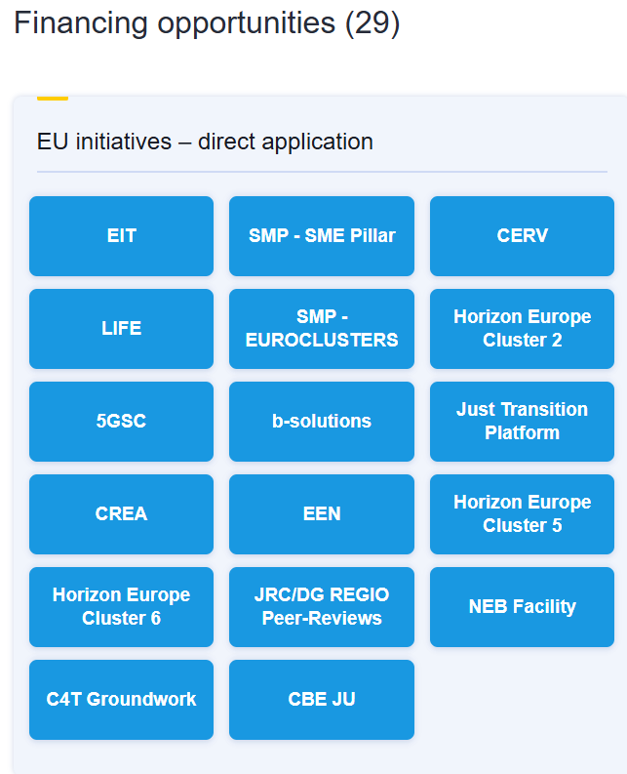
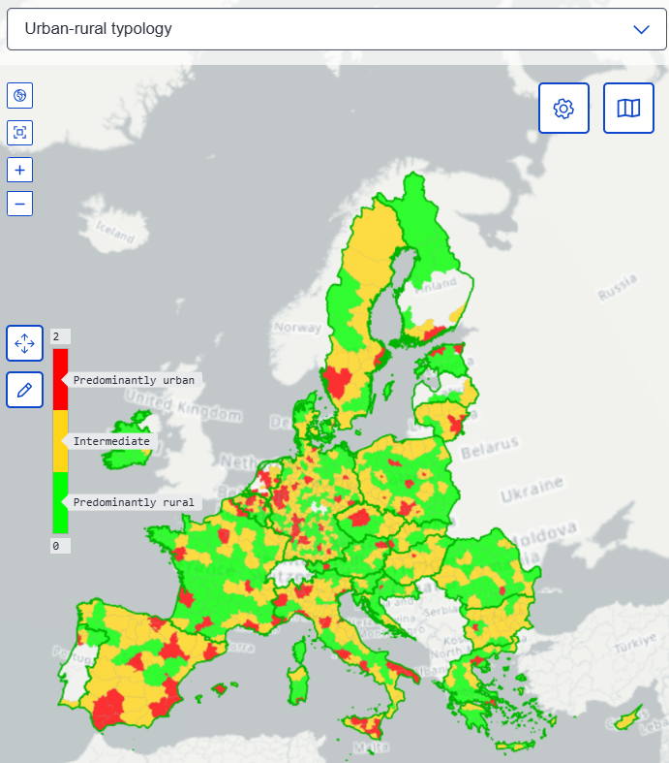
The rural action plan: horizontal actions
EU Rural Observatory
Rural toolkit on EU funding
Offers relevant statistics, indicators and analyses
Supports knowledge production - important source of information for rural proofing
Comprehensive guide to EU funding and support opportunities for rural areas
Intended for local authorities, institutions and stakeholders, businesses and individuals
Collects existing EU funds, programmes and other support initiatives
Features practical examples and case studies, as well as practical guidance and knowledge
Improves collection and dissemination of data related to EU rural areas - provides evidence for policymaking
The data covers economic, social and environmental dimensions
https://observatory.rural-vision.europa.eu/?lng=en&ctx=RUROBS
https://funding.rural-vision.europa.eu/?lng=en
Notes:
The Rural Observatory is coordinated by the Joint Research Centre (JRC) of the European Commission.
It was launched with one clear ambition: give everyone access to essential data about rural areas to foster a better understanding of their circumstances and diversities, hence increasing the analytical capacities for evidence-based policies.
A hundred indicators from multiple sources are included, covering economic, social and environmental dimensions at different levels of granularity.
Website: https://observatory.rural-vision.europa.eu/?lng=en&ctx=RUROBS
The Rural toolkit on EU funding was launched on 6 February 2024 by the European Commission’s Joint Research Centre (JRC) to support practitioners with making use of and combining the various EU funds for rural areas, beyond the CAP and Cohesion Policy.
Website: https://funding.rural-vision.europa.eu/?lng=en

Slide 16
The Rural Pact and its Support Office

Slide 17
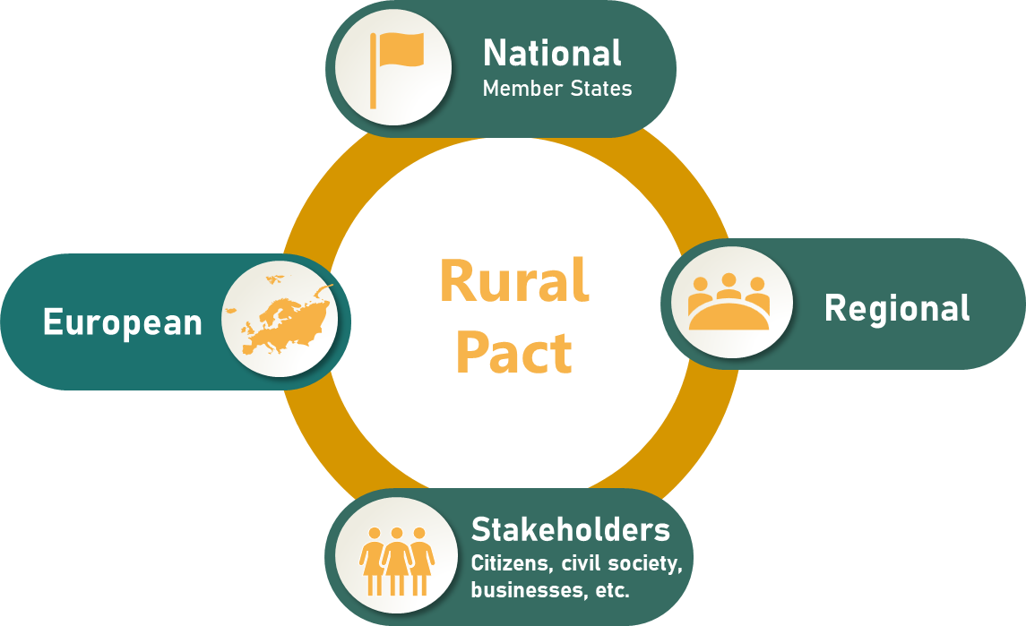




The Rural Pact – a space to work together
The Rural Pact is a formal space and framework to boost cooperation between national, regional and local governments, civil society organisations, businesses, academics and citizens to act towards the shared goals of the rural vision.
Objectives
Amplifying rural voices and bringing them higher on the political agenda
Policies
Structuring and enabling networking, collaboration & mutual learning
Capacities & Networking
Encouraging and monitoring voluntary actions for the vision
Action
Rural Pact Proposal: https://agriculture.ec.europa.eu/system/files/2022-07/rural-pact-proposal_en.pdf
Notes:
The European Commission set up the Rural Pact in December 2021, together with the Rural Pact community. It has then worked with the community and a Rural Pact preparatory group and come up with a proposal that was endorsed at the Rural Pact Conference on 15-16 June 2022.
The Rural Pact is a formal space and framework to boost cooperation between national, regional and local governments, civil society organisations, businesses, academics and citizens to act towards the shared goals of the Rural Vision.
It is this diverse community that will seize this opportunity for a European rural agora for discussion and interaction. The Rural Pact belongs to all actors willing to make the difference in EU’s rural areas and aims to act as a network for governance of rural issues, complementing the Commission Rural Action Plan, amplifying rural voices and giving them direct access to EU level.
The Rural Pact has three objectives:
Amplifying rural voices by bringing up key rural concerns in the policy agendas and making these voices acted upon.
Networking, collaboration & mutual learning
Encourage voluntary actions for the rural vision: these specific actions submitted to the Rural Pact by individuals and organisations. For instance, a rural municipality is implementing a renewable energy community to support the green transition of the area, involving and mobilising 200 citizens and businesses.
The value of the Rural Pact was confirmed in the Vision for Agriculture and Food (Feb 2025) which proposes that it be strengthened: https://agriculture.ec.europa.eu/overview-vision-agriculture-food/vision-agriculture-and-food_en

Slide 18
The Rural Pact Support Office
The Rural Pact
Rural Pact Support Office
Provides facilitation services to the Rural Pact community
Networking and information
Builds synergies with networks and governing bodies
Evaluates needs of the RP community and support its work
https://ruralpact.rural-vision.europa.eu/RPSO_en
Notes:
How is the Rural Pact coordinated ?
The Rural Pact Support Office (RPSO) coordinates and implements the networking activities of the Rural Pact and its community with the ambition to achieve the Rural Pact objectives and the long-term vision for EU’s rural areas (LTVRA). The RPSO builds synergies and complementarities with all relevant EU policy networks and initiatives working on and for rural development to jointly contribute to stronger, connected, prosperous and resilient rural areas in Europe, including the CAP Network, Broadband Competence Office Support Facility, Territorial Agenda 2030, Preparatory Action Smart Rural 21 & 27, or with the Talent Booster Mechanism.

Slide 19
The Rural Pact Support Office
Good Practices
Animation, networking, capacity building
Good Practice Webinars
Rural Pact
Support Office
Network of national partners, events in EU member states
Policy Action Labs
Website, social media
Actions for the
rural vision & political commitments
Newsletters, Magazine, Policy Briefing, Good Practice Brochure
Notes:
The Rural Pact Support Office
The Rural Pact Support Office (RPSO) coordinates and implements the networking activities of the Rural Pact and its community with the ambition to achieve the Rural Pact objectives and the long-term vision for EU’s rural areas (LTVRA).
The RPSO is tasked with:
animating the members of the community as well as encourage and promote actions to act; the RPSO is responsible for ensuring that the Rural Pact community is engaged and proposes actions to fulfil the ambitions set out in the LTVRA. The RPSO interacts with stakeholders who act for the rural vision to evaluate their needs and accompany them as well to attract new members.
identifying and promoting good practices that can inspire action in rural areas;
organising webinars for capacity building and peer learning, as well as high-level policy events;
keeping the community informed through the website, social media channels, the monthly newsletter and the annual Magazine;
supporting Rural Pact implementation in EU Member States through cooperation with national partners, organisation of national dialogues, and “Rural Pact in my country” events to engage national and regional stakeholders.

Slide 20
Rural Pact activities & Community Platform tools

Slide 21
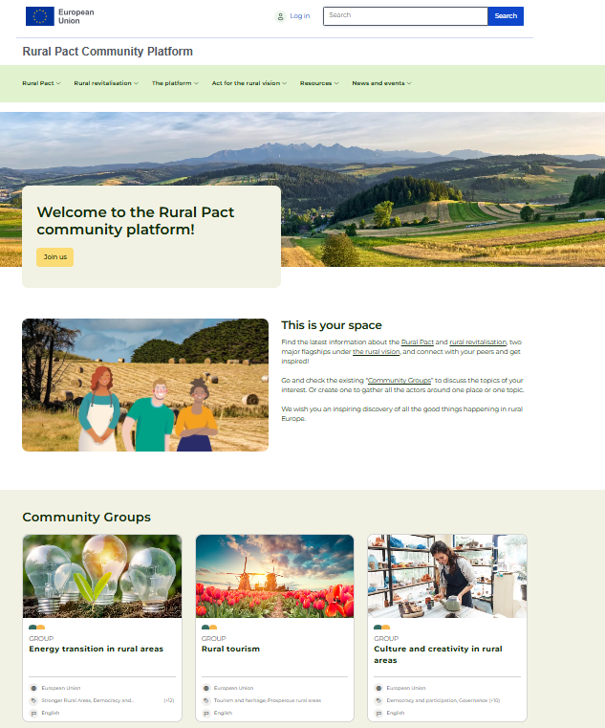
The Rural Pact Community Platform
  An online collaborative tool to find all the latest information about the Rural Pact and rural revitalisation, and to interact.
  Registration as a member of the Rural Pact through the platform is required to benefit from online collaboration tools.
https://ruralpact.rural-vision.europa.eu/index_en
Notes:
One of the biggest flagships is the Rural revitalisation platform which has been integrated in a broader platform serving all activities under the Rural Pact.
Under this platform you can create your own profile, interact with others in community groups and access resources.
Under resources, you can find a wealth of good practices.

Slide 22
Rural Pact activities & online Community Platform tools
Networking & collaboration
Connect with peers
Join or Create community groups
Participation & exchange
Policy & networking events
Online Community Platform
Information & resources
News, publications, good practices, country pages, knowledge hub
Actions for the rural vision
Political commitments & Community actions
Notes:
Rural Pact activities fall under four broad categories: networking and collaboration; policy participation and exchange; collection of information and resources; actions towards the objectives of the rural vision.
The following slides go into detail of each activity.

Slide 23
Rural Pact Community Platform tools
Networking & collaboration
Connect with peers
Join / Create community groups
Over 4 400 Rural Pact Community members (by September 2026)
Searchable by:
Country
Focus (Rural Pact or Rural Revitalisation)
Topic
Fund of interest
Only for registered members
13 Community Groups
Covering topics such as: Social economy; Youth; Migrants; Mountain areas; Women; Smart Villages; Culture; Tourism; Energy transition; Depopulation
Led by stakeholders/institutions
Exchange of information, news, events, good practices, and more
Email notifications of new posts to all members
Only for registered members
Become a member: https://ruralpact.rural-vision.europa.eu/become-member_en
Notes:
Online tools for peer exchange include the ‘user search’ and topical ‘community groups’ – only available to registered platform members.
Become a member at: https://ruralpact.rural-vision.europa.eu/become-member_en

Slide 24
Rural Pact activities
Participation & exchange: policy and networking events
Web section of upcoming and past Rural Pact & stakeholder events
Rural Pact events in 2026
Good Practice Webinars
Integrated Territorial Instruments: 22 Apr 2026
Generational renewal in rural businesses: 10 Jun 2026
Strengthening rural businesses: 17 Sep 2026
Rural resilience: 26 November 2026
Policy Labs
Anchoring rural areas in the National and Regional Partnership Plans: 3 June 2026
Strengthening a diversified rural economy in the post-2027 period: 29 Sep – 1 Oct 2026
Rural Pact in my country webinars
Latvia: 9 June 2026
Poland: 19 June 2026
Flanders (BE): 21 October 2026
Hungary: date tbc
High-level Policy Forum
Responding to rural priorities through integrated national and regional strategies and LEADER: 3-4 November 2026
National Rural Pact events
France: 15 December 2026
https://ruralpact.rural-vision.europa.eu/events/upcoming_en
Notes:
Browse through a wealth of Rural Pact and stakeholder in-person and online events: https://ruralpact.rural-vision.europa.eu/events/all_en

Slide 25
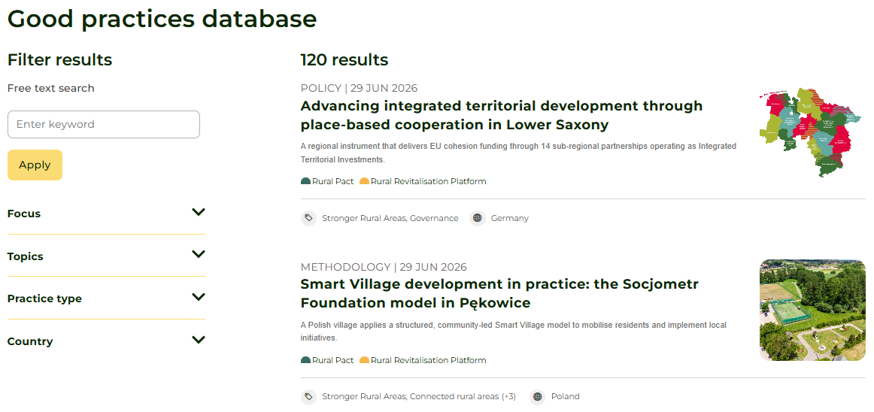
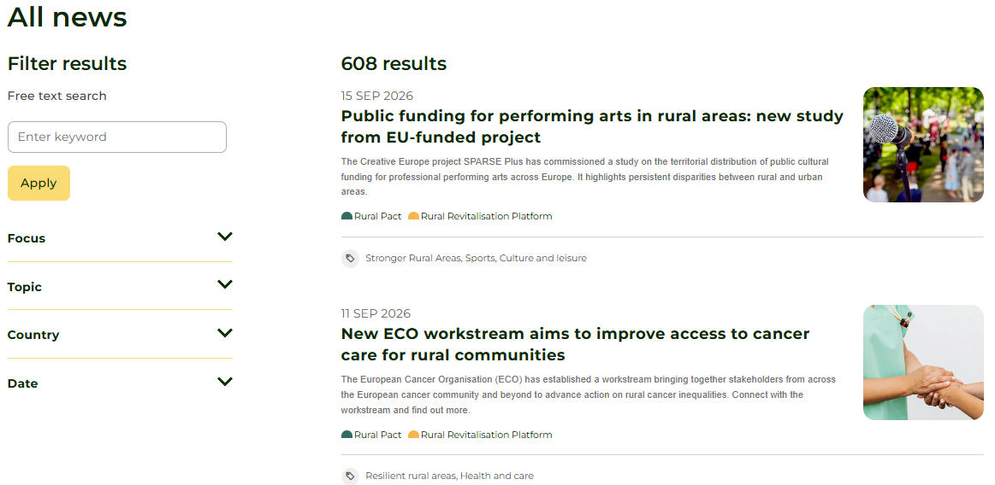
Rural Pact Community Platform tools
Information & resources
Good Practices
News
Types: projects; methodologies; case studies; policy; tools
Web section of Rural Pact and stakeholder news
Past editions of the newsletter
https://ruralpact.rural-vision.europa.eu/good-practice/search_en
News: https://ruralpact.rural-vision.europa.eu/news/search_en
Notes:
The Rural Pact Good Practices cover a range of past and ongoing projects, policies, tools and methodologies that can inspire other actions to contribute to rural revitalisation and the objectives of the Rural Pact. Such examples can help mobilise, encourage, or build the capacity of policymakers and local actors by promoting innovative ways of dealing with rural challenges.
The website news section brings together a rich collection of Rural Pact and stakeholder news. You can propose a news item relevant for achieving the objectives of the rural vision and Pact by writing to communications@rural-pact.eu.

Slide 26
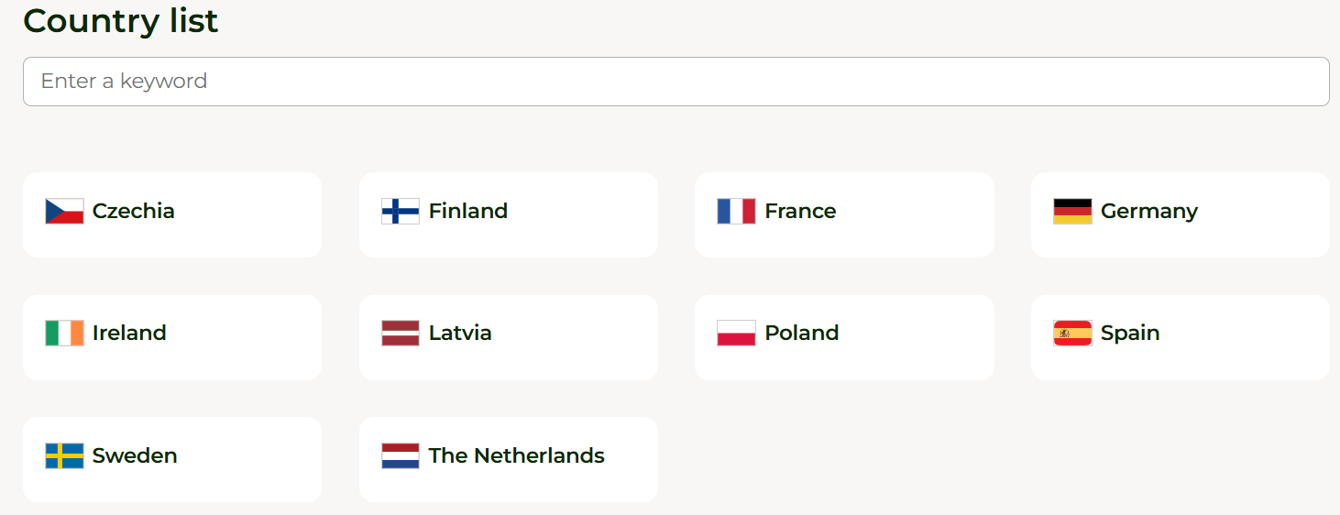
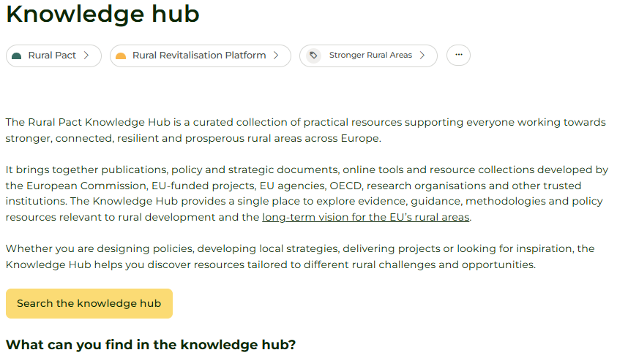
Rural Pact Community Platform tools
Information & resources
Country pages
Knowledge Hub
Examples, initiatives, and actions that realise the Pact at national and regional levels
Ten country pages – more in development in 2026
One-stop-shop for relevant resources to the EU rural vision, developed by key rural stakeholders
140+ resources
Types: tools; studies; guides; databases; research
Country pages: https://ruralpact.rural-vision.europa.eu/countries_en
https://ruralpact.rural-vision.europa.eu/knowledge-hub_en
Notes:
The country pages are intended as repositories of relevant examples, inspirational initiatives, and actions that realise the Pact at national and regional levels. The pages are structured along the key elements outlined in the Policy Briefing ‘Making the Rural Pact happen in Member States’: https://ruralpact.rural-vision.europa.eu/publications/making-rural-pact-happen-member-states_en
The Knowledge Hub is a one-stop-shop to access relevant tools, studies, guides, case studies, databases and research developed by key rural stakeholders and which are relevant to the long-term vision for rural areas.

Slide 27
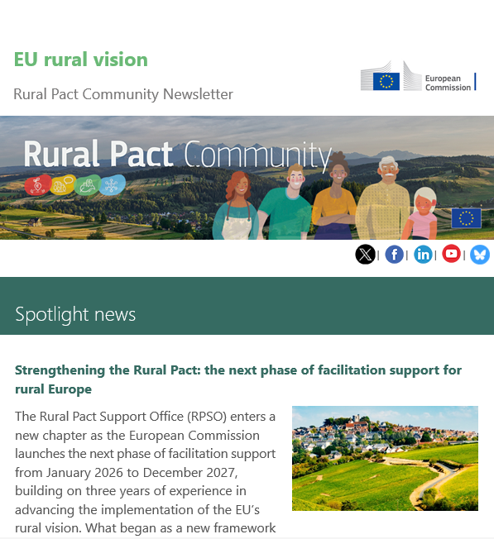
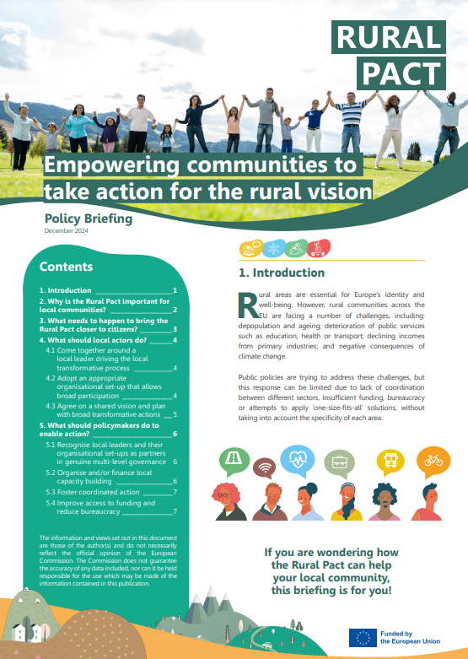
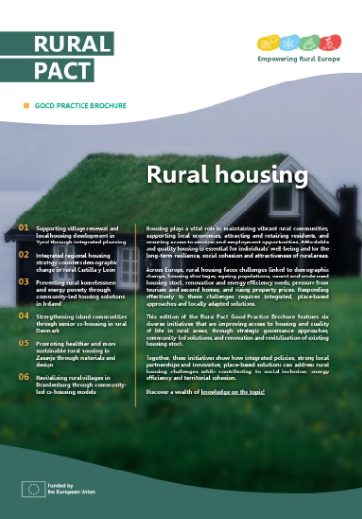
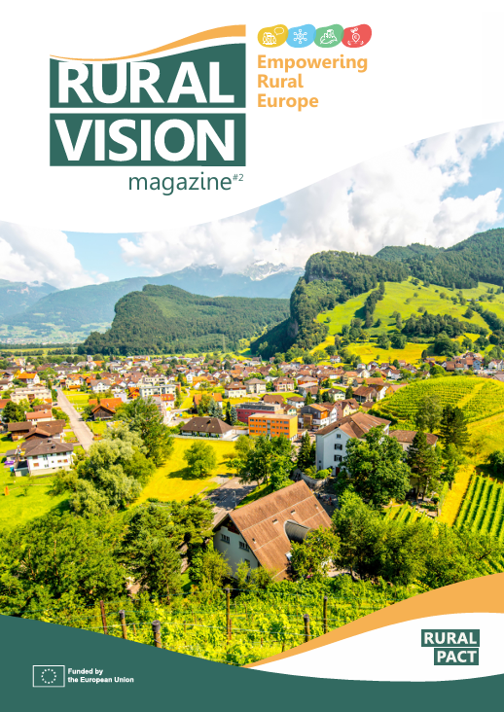
Rural Pact publications
Information & resources
Publications
Newsletter
11 editions per year
Over 4 300 recipients
Rural Vision Magazine
Available in EN, FR, DE
Good Practice Brochure
Quarterly, thematic publication
Policy Briefings
Available in all official EU languages
https://ruralpact.rural-vision.europa.eu/publications/search_en
Notes:
Whether you are a policymaker, researcher, or passionate advocate, the Rural Pact publications are valuable resources for keeping informed and getting inspired by the ongoing efforts to create prosperous, stronger, connected and resilient rural areas.

Slide 28
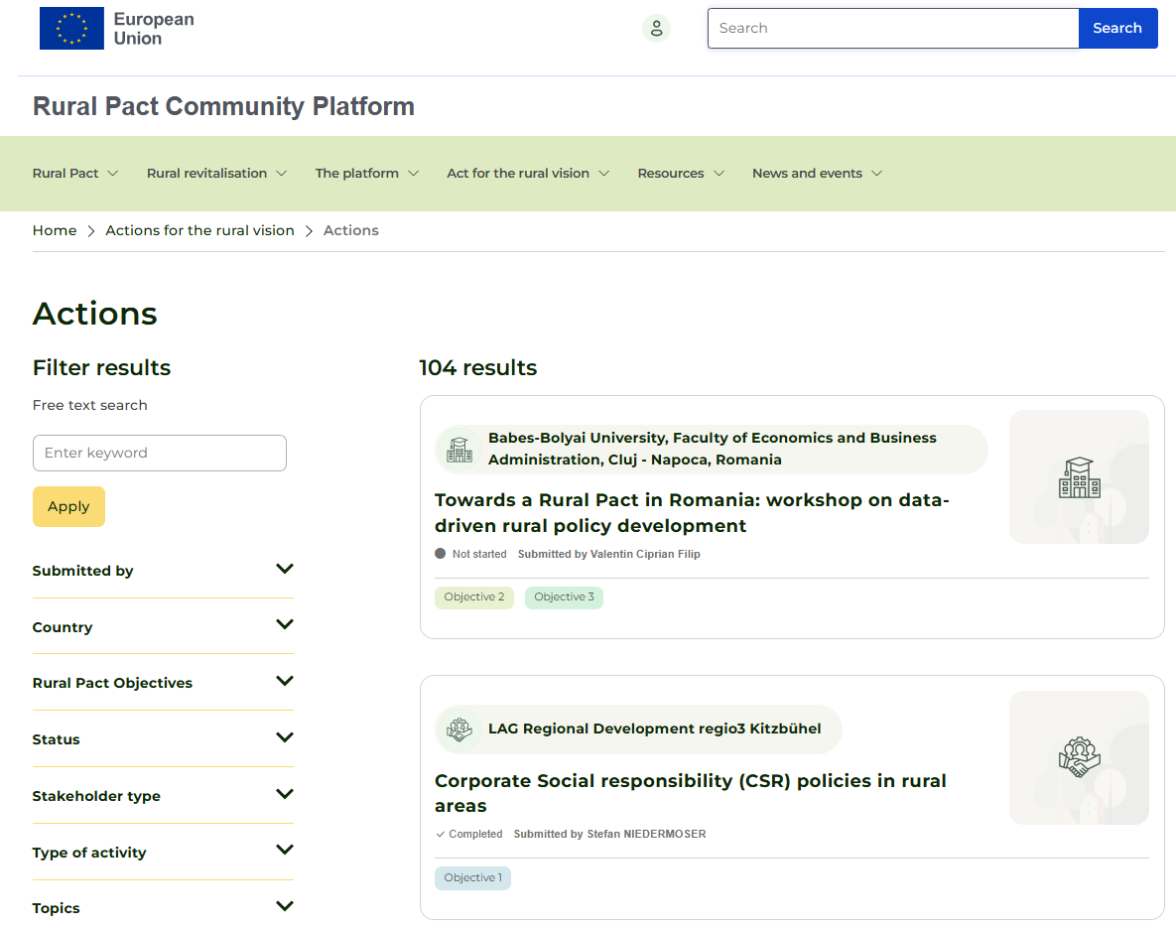
Rural Pact Community Platform tools
Actions for the rural vision
Stakeholder actions
Voluntary stakeholder actions towards the shared goals of the rural vision
Types: policies & advocacy; capacity building & knowledge; events & networking; local projects; other
Who can submit an action: everyone, either in individual or organisational capacity; need to be/become member of the platform
Why submit an action?
Gain pan-European visibility for your action
Inspire others to act
Bring up key rural needs, demonstrate power of rural action, and influence political agendas
https://ruralpact.rural-vision.europa.eu/actions-rural-vision/actions/search_en
Notes:
All individuals and organisations interested in contributing to the shared goals of the rural vision are invited to take an action to the rural vision. These actions overview your willingness and proposed idea to act for the development of European rural areas.
Everyone can contribute according to their capacity and no action is too small!

Slide 29
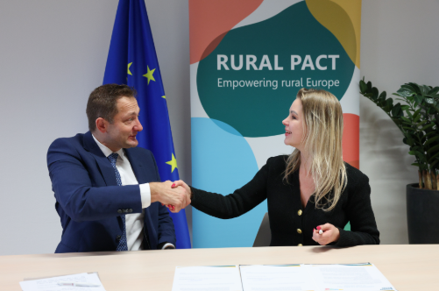
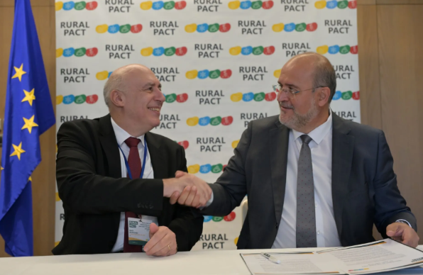
Rural Pact Community Platform tools
Commitments to the Rural Pact
Public Authorities’ Commitments
Ten commitments to date
Hungarian Ministry for Regional and Rural Development
Asturian Ministry of Rural Environment & Agrarian Policy (ES)
Finnish Ministry of Agriculture and Forestry
Dutch Ministry of Agriculture, Fisheries, Food Security
Czech Ministry for Regional Development
Opolskie Voivodeship (PL)
Catalan Regional Government (ES)
Castilla-La Mancha's Regional Government (ES)
Andalusian Regional Government (ES)
European Economic and Social Committee (EECS)
Commitments to the Rural Pact made by national and regional governments, as well as EU institutions and bodies, expressing their support to the EU’s rural vision.
https://ruralpact.rural-vision.europa.eu/public-authorities-commitments_en
Notes:
These are commitments made by national and regional governments, as well as EU institutions and bodies, expressing support to the EU’s long-term vision for rural areas.
Public authorities are invited to join the Rural Pact and commit to act for the vision on behalf of national and regional governments. Fine out more on the submission process: https://ruralpact.rural-vision.europa.eu/fostering-commitments-rural-pact-government-level_en

Slide 30
What’s in the rural vision and the Rural Pact for you?
What can you do?
What’s in it for you? | What can you do?
Momentum created at EU level for more and better targeted action for rural areas | Use this momentum in your respective countries, regions and local areas to ask for improvements
Rural Pact Coordination Group: a governance body to steer the Rural Pact, connecting institutions and networks (thematic, sectoral, rural) acting for the benefit of rural communities across Europe | Use your membership in networks to make your ideas better known and contribute to positive outcomes at EU and national levels
Rural Pact Community Platform to learn from and exchange with others & create your own online space (group) to share information Rural Pact community Newsletter, to be informed about news, events, good practices, publications, funding etc. | Engage and share to enrich collective knowledge and help ideas for actions to emerge – contact us at info@rural-pact.eu to share your news, events, good practices, publications & more
Increased visibility for what actors do & ideas of initiatives to take (Actions for the rural vision) | Get inspired and inspire others: promote what you do in the Pact context to create critical mass
Tools created by the EU Rural Action Plan: EU Rural Observatory (access to data), EU toolkit on Rural Funding (help identify the right funding schemes), framework for rural proofing at national, regional and local levels | Use the tools and tell us how you would like to see them improved (mindful of resources) Encourage national and regional authorities in your country to use these tools or build similar ones
Funding opportunities under various programmes contributing to the EU Rural Action Plan (Horizon EU, ERASMUS+, Single Market etc.) | Stay tuned and apply to benefit! If you find it difficult, help us understand why

Slide 31
The way forward to the post-2027 rural policy framework

Slide 32
The EU rural vision: key achievements and ways forward
European Commission report (March 2024)
Takes stock of actions carried out since the Commission Communication on the rural vision (Jun 2021)
Informs a reflection on proposals for EU policies in the post-2027 programming period
Outlines possible ways forward for the EU Rural Action Plan and the Rural Pact
Provides an overview of new indicators and latest data on rural areas
Sets out nine questions for reflection based on prominent topics raised by EU institutions and bodies, and stakeholders to date
https://eur-lex.europa.eu/legal-content/EN/ALL/?uri=comnat:COM_2024_0450_FIN
Notes:
The European Commission adopted its report on the implementation of the EU’s rural vision on 27 March 2024. The document takes stock of the actions that have been carried out since the publication of the Commission Communication in June 2021.
It provides an overview of new indicators and latest data on rural areas; looks back at 30 months of implementation of the rural vision; and outlines possible ways forward for the EU Rural Action Plan and the Rural Pact.
Questions for reflection on the ways forward:
What are the key challenges arising from depopulation, ongoing transitions and structural changes?
What are the best ways to address them in a targeted way that takes due account of the diversity of rural areas?
How to enhance financial support for rural areas and communities through EU, national and regional funds, including improving synergies and complementarities?
What is needed to improve financing, quality of delivery and effectiveness via e.g. CLLD/LEADER?
How to improve the monitoring and assessment of the resources from the different EU funds and programmes?
What is needed to improve access to support for the final beneficiary?
What can be done for wider implementation of the rural proofing mechanism at all levels?
What are the best policy tools to ensure institutional, governance and integrated support for rural areas?
How to improve the availability of policy-relevant rural statistics and data, without increasing the administrative burden?

Slide 33
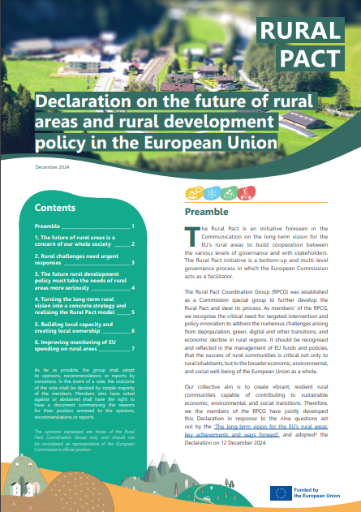
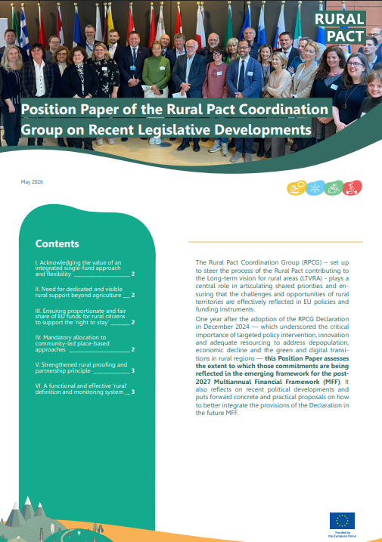
Rural Pact Coordination Group (RPCG) policy recommendations for the future of rural areas
RPCG (2023-2026): European Commission special group bringing together Rural Pact Community representatives to provide strategic guidance and recommendations on Rural Pact implementation.
Declaration on the future of rural areas and rural development policy in the EU
RPCG (Dec 2024)
Position paper on legislative developments around the post-2027 MFF
RPCG (May 2026)
Strategic proposal for the post-2027 rural policy framework
Collective response to the questions in the EC report on ‘the EU rural vision: key achievements and ways forward’
Available in 24 EU languages
Assessment of the emerging post-2027 EU policy framework
Strategic recommendations to strengthen rural proofing, place-based governance and dedicated support for rural areas
https://ruralpact.rural-vision.europa.eu/RPCG_en
Notes:
The Rural Pact Coordination Group (RPCG) served as a European Commission special group with a three-year mandate (2023-2026), bringing together representatives of the Rural Pact Community to provide strategic guidance on the implementation of the Rural Pact.
Led by DG Agriculture and Rural Development, with DG Regional and Urban Policy as co-lead, the RPCG contributed strategic recommendations to the European Commission, including:
The RPCG Declaration, adopted on 12 December 2024, sets out a strategic proposal for the post-2027 EU funds and policies to address the challenges faced by rural areas. It calls for a strong shift in future policies to ensure the sustainability and resilience of EU’s rural areas in the long run, suggesting:
Increased and streamlined funding for rural areas through a compulsory minimum allocation to rural areas from all post-2027 EU funds and a better resourcing of community-led, place-based approaches, such as LEADER and Smart Villages;
Enhanced coordination among relevant administrative bodies at all governance levels, compulsory implementation of the Rural Pact model, including multi-fund and multi-stakeholder coordination, and guidance and training for the implementation of ‘rural proofing’;
Capacity building for local actors, including on access to funding, tailored interventions reflecting the diversity of rural areas and their particular needs, and extended use of data to inform evidence- and result-based future policies.
https://ruralpact.rural-vision.europa.eu/publications/rural-pact-coordination-group-rpcg-declaration-future-rural-areas-and-rural_en
Building on the Declaration, the RPCG position paper, adopted in May 2026, responds to the European Commission's emerging legislative proposals for the post-2027 EU policy framework. It welcomes the stronger recognition of territorial cohesion and rural areas, while identifying remaining gaps and putting forward recommendations to ensure that future EU policies better address rural needs.
In particular, it advocates stronger rural proofing, integrated place-based and community-led approaches, partnership-based governance, dedicated support for rural areas beyond agriculture, and more coherent coordination of funding and policies across sectors and governance levels.
https://ruralpact.rural-vision.europa.eu/publications/rural-pact-coordination-group-rpcg-position-paper-legislative-developments-around-post_en

Slide 34
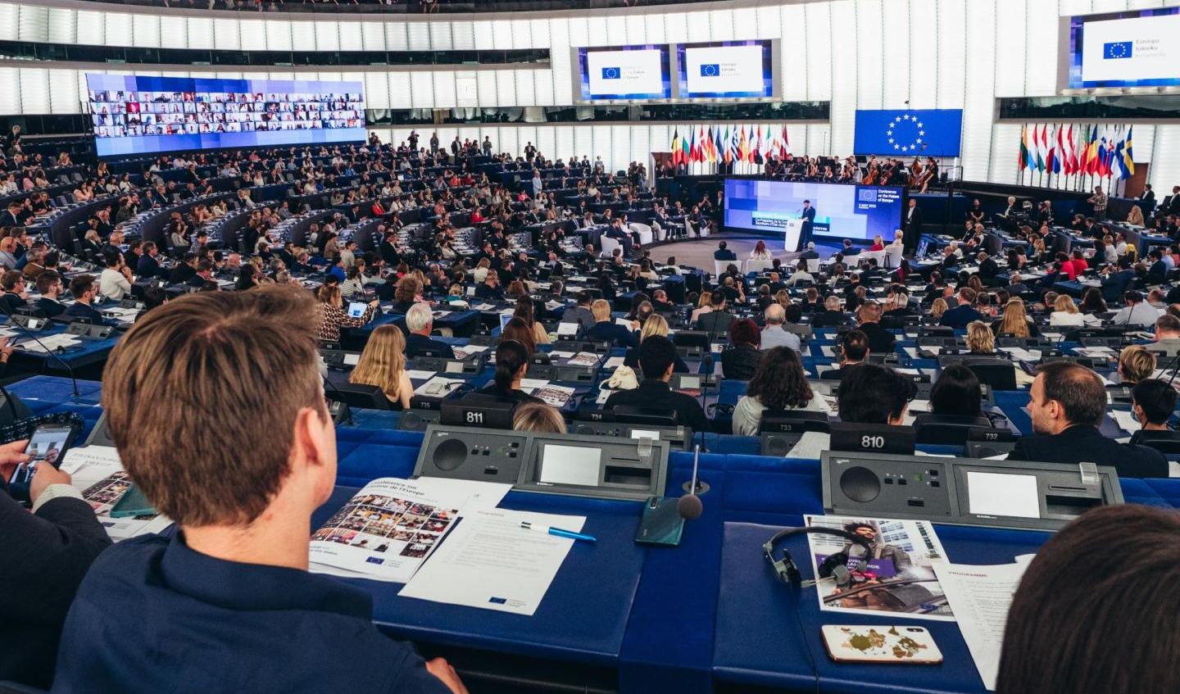
The road to the next Multiannual Financial Framework
European Commission Communication (Feb 2025)
Groundwork for reflections on how to adapt the EU's long-term budget to evolving needs and priorities
Outlines the key policy and budgetary challenges
Sets out a new approach towards making the EU budget simpler, more impactful, and more focused
Plan for each country with key reforms and investments, designed and implemented in partnership with national, regional, and local authorities
A series of public consultations ran until 6 May 2025
European Commission’s formal proposal on the EU’s long-term budget was presented in July 2025
https://ec.europa.eu/transparency/documents-register/detail?ref=COM(2025)46&lang=en
Notes:
The Commission Communication sets out the key policy and budgetary challenges that will shape the next EU long-term budget, post 2027.
The Communication lays the groundwork for reflections on how to adapt the EU's long-term budget to evolving needs and priorities. It outlines the key policy and budgetary challenges that will shape the design of the next Multiannual Financial Framework (MFF). These include growing geopolitical tensions, irregular migration, food security and nature protection, climate change, remaining barriers within the single market.
The document sets out a new approach towards making the EU budget simpler, more impactful, and more focused. It calls for a true policy-based budget ensuring synergies between policies; greater simplification, coherence, focus on performance; maximising public investment and leveraging private capital; a balance between predictability for long-term investments and flexibility to respond to crises.
The new approach to the EU budget also includes a plan for each country with key reforms and investments, designed and implemented in partnership with national, regional, and local authorities, a new Competitiveness Fund, and modernised revenues.
In parallel, the Commission invited all Europeans to have their say on the next budget and the policies it should support through a series of public consultations (these closed on 6 May 2025).

Slide 35
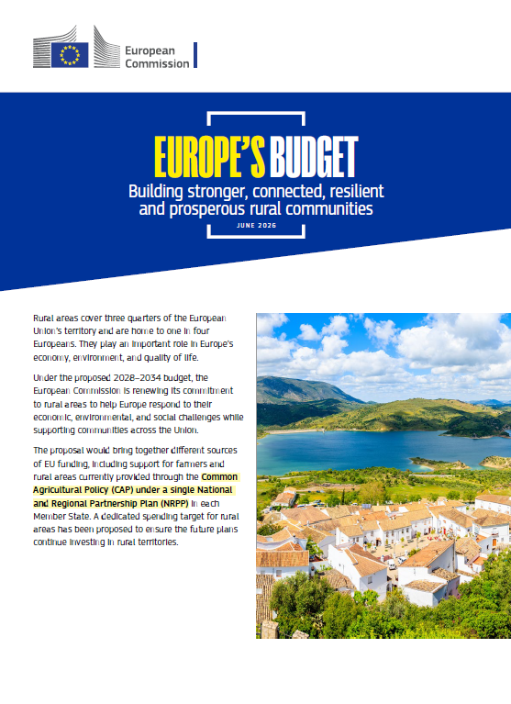
Proposed support for rural areas under the 2028-2034 EU budget
European Commission factsheet (June 2026)
Dedicated rural target: at least 10% of each NRPP allocation, excluding CAP and CFP ringfenced amounts, for investments in rural areas – at least €48.7 billion EU-wide
Integrated approach: combine investments and reforms across policy areas to address rural needs, services, infrastructure and economic opportunities
Place-based tools: continued support for LEADER/CLLD, Smart Villages and integrated territorial approaches
Rural priorities: improve quality of life, attractiveness and prosperity, including services, healthcare, jobs and generational renewal
Rural participation: the partnership principle requires involvement of rural stakeholders in shaping investment priorities and territorial responses
https://op.europa.eu/en/publication-detail/-/publication/69906998-692e-11f1-9b18-01aa75ed71a1/language-en?
Notes:
In June 2026, the European Commission published a factsheet explaining how its proposed 2028-2034 EU budget could support rural areas. The proposals remain subject to negotiations between the European Parliament and the Council.
Under the proposed architecture, different sources of EU funding would be brought together under a single National and Regional Partnership Plan in each Member State, including support for farmers and rural areas currently provided through the CAP.
A significant element for rural areas is the proposed dedicated rural spending target. Each Member State would be required to dedicate at least 10% of its NRPP allocation – excluding amounts ringfenced under the CAP and Common Fisheries Policy for income support – to investments in rural areas. This represents at least EUR 48.7 billion across the EU. A dedicated tracking category would monitor planned and actual expenditure under this target.
The proposal places particular emphasis on an integrated approach to rural development. Member States would be encouraged to combine different policy areas and funding sources to address rural challenges comprehensively – for example, connecting economic development with services, infrastructure, connectivity, social inclusion, education, culture and the energy transition.
Place-based approaches remain important. LEADER would be mandatory to programme in each Member State, at least for rural areas facing specific disadvantages, and could be extended across a broader range of policy sectors through multi-sector Community-led Local Development. The framework would also enable support for Smart Villages and integrated territorial investments.
The factsheet also emphasises integrated rural strategies and governance. Member States are encouraged to develop integrated planning approaches and governance structures coordinating EU, national, regional and local policies and funding. It explicitly refers to the seven Rural Pact ingredients and OECD Principles on Rural Policy as resources that can support such approaches.
Finally, stakeholder participation is an important part of the proposed framework. Under the partnership principle, Member States would involve relevant authorities and stakeholders when defining investment priorities and territorial needs. The Commission states that, when assessing NRPPs, it will pay particular attention to how rural stakeholders have been involved in their preparation, including local and regional authorities, LEADER LAGs, rural parliaments, village associations and other rural organisations.
The proposed rural target should not be understood as the entirety of EU support potentially available to rural areas. Rural areas could additionally benefit from CAP support, the EUR 218 billion proposed for less-developed regions where applicable, as well as programmes and instruments outside the NRPPs.

Slide 36

Vision for agriculture and food (Feb 2025)
Working in synergies with the rural vision 2040
Four priority areas
An attractive agri-food sector that ensures a fair standard of living
A competitive and resilient sector in the face of global challenges
A future-proof sector that works hand-in-hand with nature
Valuing food and fostering fair living and working condition in vibrant and well-connected rural and coastal areas
Commissioner
Agriculture & Food
Christophe Hansen
https://agriculture.ec.europa.eu/overview-vision-agriculture-food/vision-agriculture-and-food_en
Notes:
A new Vision for Agriculture and Food was adopted by the European Commission in February 2025. This vision complements the long-term vision for EU’s rural areas (launched in 2021).
It sets out a roadmap on the future of farming and food in the European Union, outlining a vision for an attractive, competitive, resilient, future-oriented and fair agri-food system. Living and working conditions in rural areas are among the Vision’s four priority areas.
The Vision considers simplification of EU rules, research, innovation and digitalisation cross-cutting drivers across its four priority areas:
an attractive agri-food sector that ensures a fair standard of living;
a competitive and resilient sector in the face of global challenges;
a future-proof sector that works hand-in-hand with nature; and
valuing food and fostering fair living and working condition in vibrant rural areas.

Slide 37

Vision for agriculture and food (Feb 2025)
Working in synergy with the rural vision 2040
Specific rural actions
Enhance synergies and complementarities
EU Rural Action Plan update in 2026
Strengthen the Rural Pact
Further operationalise the rural proofing principle
Strengthen participatory, local development tools, such as LEADER/CLLD and Smart Villages
Further develop the concept of functional rural areas
Address the targeted spread of disinformation in rural areas
Notes:
Outlining the main elements of fostering fair living and working conditions in vibrant rural areas, the Vision for agriculture and food highlights the importance of strengthening the Rural Pact as a key instrument for dialogue and engagement of civil society and rural communities.
The rural proofing principle, including territorial impact assessments, is expected to be further operationalised and sufficiently resourced at EU level.
Additionally, the Vision anticipates an update of the EU Rural Action Plan in 2026, to be consolidated with projects, initiatives and actions from numerous EU policies to respond to the post-2027 policy priorities.
Participatory, local development tools, such as LEADER/CLLD and Smart Villages, will be further strengthened, while the ‘functional rural areas’ concept will be further developed to address the gap in availability and affordability of services for rural residents.

Slide 38

Strategy for generational renewal in agriculture (Oct 2025)
Revitalising rural communities through new generation of farmers
Five priority areas
Access to credit and finance;
Success to knowledge and skills;
Access to land;
Resilience, fair living conditions and access to income opportunities;
Succession and retirement.
Commissioner for
Agriculture & Food
Christophe Hansen
https://agriculture.ec.europa.eu/overview-vision-agriculture-food/generational-renewal_en
Notes:
A New Strategy for Generational Renewal in Agriculture
The Strategy was adopted by the European Commission in October 2025. It builds on the EU’s long-term rural development priorities and complements the Vision for Agriculture and Food (2025).
The strategy provides a roadmap for empowering young farmers and strengthening rural areas, aiming to ensure that farming is sustainable, innovative, and attractive for the next generation. It emphasises improving living and working conditions, supporting farm succession, and fostering vibrant rural communities.
The strategy focuses on five main pillars:
First, access to credit and finance. The strategy recognises that lack of affordable capital is one of the biggest barriers for new entrants, and therefore promotes financial instruments, guarantees, and investment support for young farmers.
Second, access to knowledge and skills. Farming today requires not only traditional know-how but also digital, environmental, and business skills. The strategy strengthens training systems, advisory services, and innovation networks to support this.
Third, access to land. This is one of the most structural barriers. The strategy promotes fairer land markets, transparency, and tools to support farm transfer and reduce land speculation.
Fourth, resilience, fair living conditions, and income opportunities. This connects generational renewal to rural attractiveness, because young people will only stay in farming if rural areas offer quality infrastructure, services, and a decent standard of living.
And finally, succession and retirement. The strategy directly addresses the “missing link” between generations by supporting smoother farm transfer and ensuring that older farmers can retire with dignity while opening space for new entrants.

Slide 39

Strategy for generational renewal in agriculture (Oct 2025)
Revitalising rural communities through a new generation of farmers
Specific rural actions
Enhance rural living conditions, including broadband, transport, healthcare, and childcare
Promote rural economic diversification through agri-tourism, bioeconomy, and non-farm entrepreneurship
Support local rural development and networking through LEADER/Community-led Local Development (CLLD), promoting youth and women’s involvement and reducing rural isolation.
Establish Rural Youth Ambassadors to engage young people and strengthen rural identity
Notes:
The Strategy for Generational Renewal in Agriculture aims to revitalise rural areas by enabling a new generation of farmers to thrive and by strengthening the social and economic fabric of rural communities.
The strategy emphasises the need to enhance rural living conditions. This includes improving access to essential services such as broadband, transport, healthcare, and childcare. The idea is simple: if rural areas are to attract and retain young people, they must offer the same basic opportunities and quality of life as urban areas. Connectivity and services are not extras, they are preconditions for rural attractiveness.
The strategy also promotes rural economic diversification. Rural areas cannot rely only on traditional agriculture. That is why there is strong support for developing agri-tourism, the bioeconomy, and non-farm entrepreneurship. These sectors create additional income opportunities, make rural economies more resilient, and open space for young people with different skills and ambitions to stay or return to rural areas.
It supports local rural development and networking, especially through instruments like LEADER and Community-Led Local Development. These approaches are important because they put decision-making in the hands of local communities. They also encourage cooperation, strengthen local networks, and actively promote the involvement of youth and women, while also addressing rural isolation.
Finally, the strategy introduces the idea of Rural Youth Ambassadors, which is about strengthening youth engagement and rural identity. The aim is to give young people a visible role in shaping rural narratives, connecting them across regions, and ensuring that rural youth voices are heard at local, national, and European level.
By aligning agricultural renewal with broader rural development goals, the strategy supports thriving rural communities, stronger local economies, and sustainable land use, all of which are central to the EU’s rural development agenda.

Slide 40
Notes:
Thank you!

