Slide 1
From vision to action: Empowering rural areas for the future 2nd Rural Pact Conference, Château du Biez​, Nearby Kortrijk/Courtrai (Belgium) 8-9 April 2025
Background information about the Rural Pact Conference 2025 &
Questions for member’s reflections prior the RPCG meeting of the 8 November

Slide 2
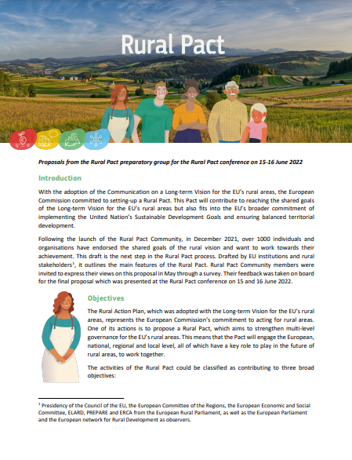
Background
1st RP Conference took place in June 2022 (almost 3 years):
Endorse the proposal for the Rural Pact with rural stakeholders
Took place in an urban area
New European Parliament & European Commission –> New policy players in place
Almost 3 years of implementation of the Rural Vision 2040, Rural Action Plan and Rural Pact
RPCG Declaration (being developed)
Rural Pact proposal

Slide 3
Focus & approach
This 2nd RP Conference will take place in a rural area, 250 participants 1.5 days
A clear focus and target on the Rural Pact Community and action at local level
Focus:
Draw lessons and co-create ideas to consolidate the implementation of the Rural Action Plan and the future policy framework.
Create networking opportunities and build capacities among the Rural Pact community to take action at the local level.
Facilitate exchanges to collect ideas and recommendations to guide the Rural Pact in the future.

Slide 4
Agenda (tentative structure)
Day 1
Political discussion + networking
Day 2
Policy exchanges + capacity building
Policy session: Moving forward with the Rural Vision and the Rural Pact
Participatory sessions: Co-create ideas to consolidate the implementation of the rural vision and pact
Networking session:
Rural Pact Community committing to action for the Rural Vision
Main recommendations: Report backs from the participatory sessions and main conclusions and recommendations

Slide 5
Agenda (draft ideas)
Day 1 (Policy and networking)
Policy session: Moving forward with the Rural Vision and the Rural Pact
Bring the new High-level EC representatives (President, Vice-president & Commissionaire)
Take stock on the work done so far by the EC to advance with the Rural Vision 2040, Rural Action Plan and the Pact, and provide inspiration from a Member States taking action
Present the RPCG Declaration
Give voice to other EU institutions (Council, EP, CoR, EESC) to express their future actions to advance with the vision and Pact as well as with the demands from the RPCG Declaration (inter-institutional panel)

Slide 6
Agenda (draft ideas)
Day 1 (Policy and networking)
Networking corners: Rural Pact Community committing to action for the Rural Vision
Create spaces to foster networking and build capacities to take actions. Spaces would be designed by e.g. Community Groups and RPCG members and RPSO.
Further engage local stakeholders in the Rural Pact process
Examples:
Share good practices, get in contact with Community Groups members, plan join initiatives, open mic sessions, space to meet and exchange with RPCG members
Dinner
Question for RPCG reflections prior the meeting: Would you / your organisation be interested to host a networking session? What would you like to do?

Slide 7
Agenda (draft ideas)
Day 2: RP Community ideas to consolidate the Rural Action Plan
Participatory session: Co-create ideas to consolidate the implementation of the rural vision and action plan
Provide a space to valorise the work that has been done so far by the EC for the Rural Action Plan, explore stakeholder needs and collect ideas to consolidate the vision and action plan – There will be 4 break out rooms to exchange on topics for stronger, connected, resilient, prosperous rural areas.
Give voice to local stakeholders to express their views
Main recommendations: Report back from the participatory sessions and main conclusions and recommendations to advance with the Pact
Final stakeholder panel: collect views from a range of stakeholder representatives (municipalities, LAGs, Civil Society, Researchers)
Question for RPCG reflections prior the meeting: What are key topics / themes for the future of rural areas which you wish explore more in-depth in the participatory sessions in day 2? Is there a theme for which you or your organisation would like to have a stronger involvement during the conference (e.g. provide a contribution, example, or lead a discussion table)?

Slide 8
Thank you!

