Slide 1
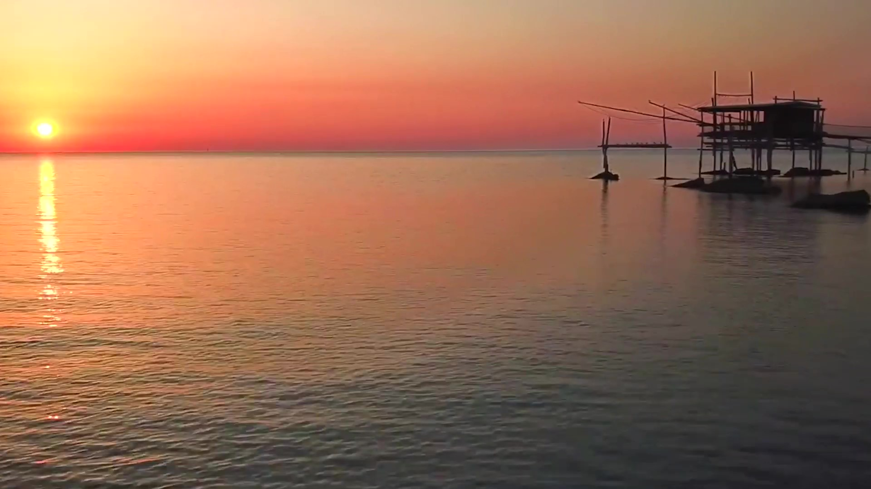

A REGION IN CHANGE
Carlo Ricci – GAL Costa dei Trabocchi

Slide 4
Costa dei Trabocchi Lab, today is a brand, but in 2019 it was a big 3 days meeting with many workshops and working groups sessions, in which a new vision and its road-map have been designed

Slide 5
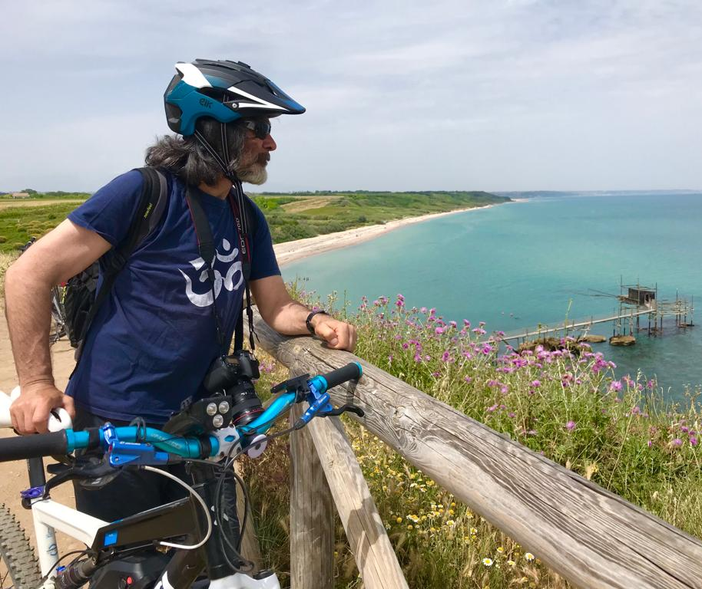
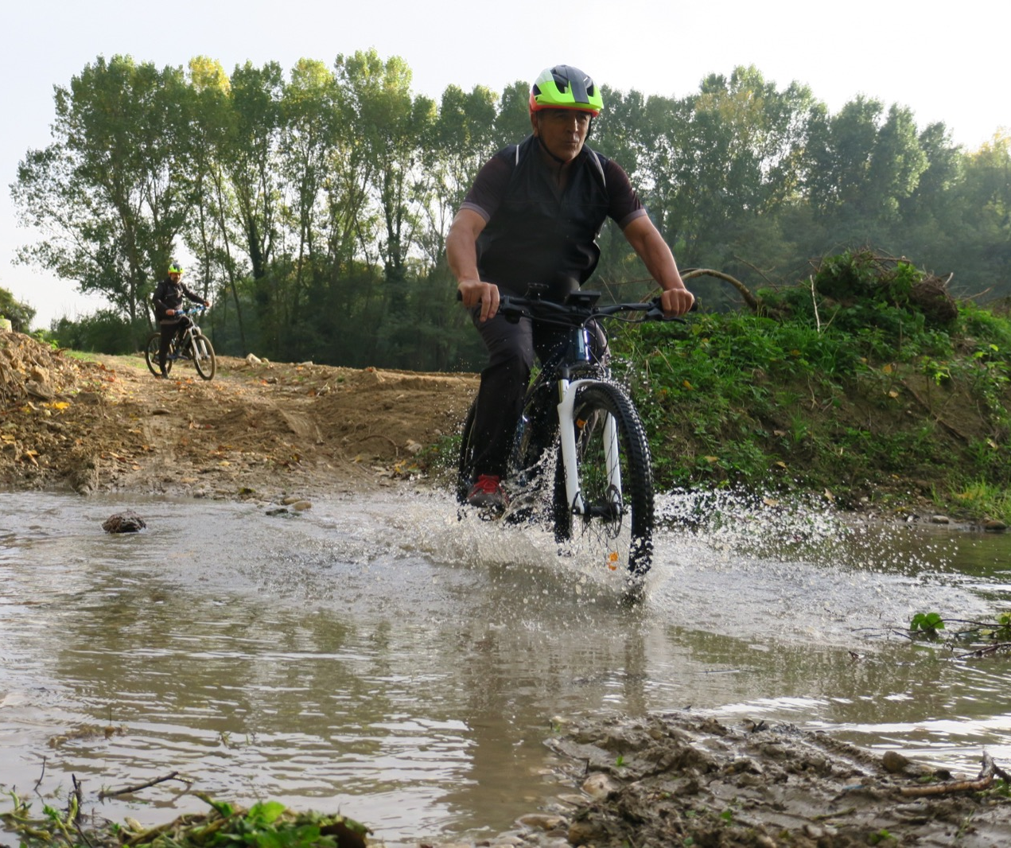
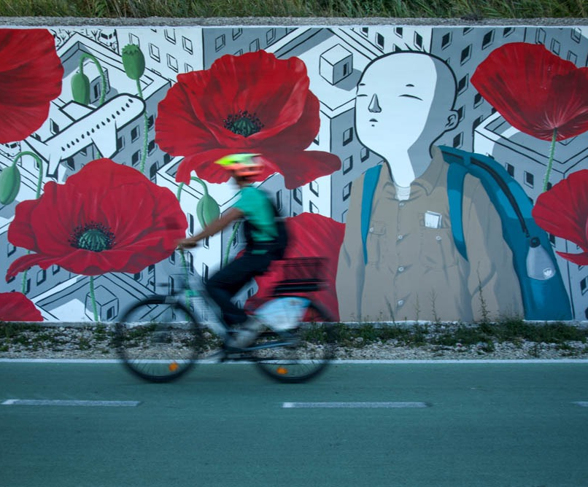
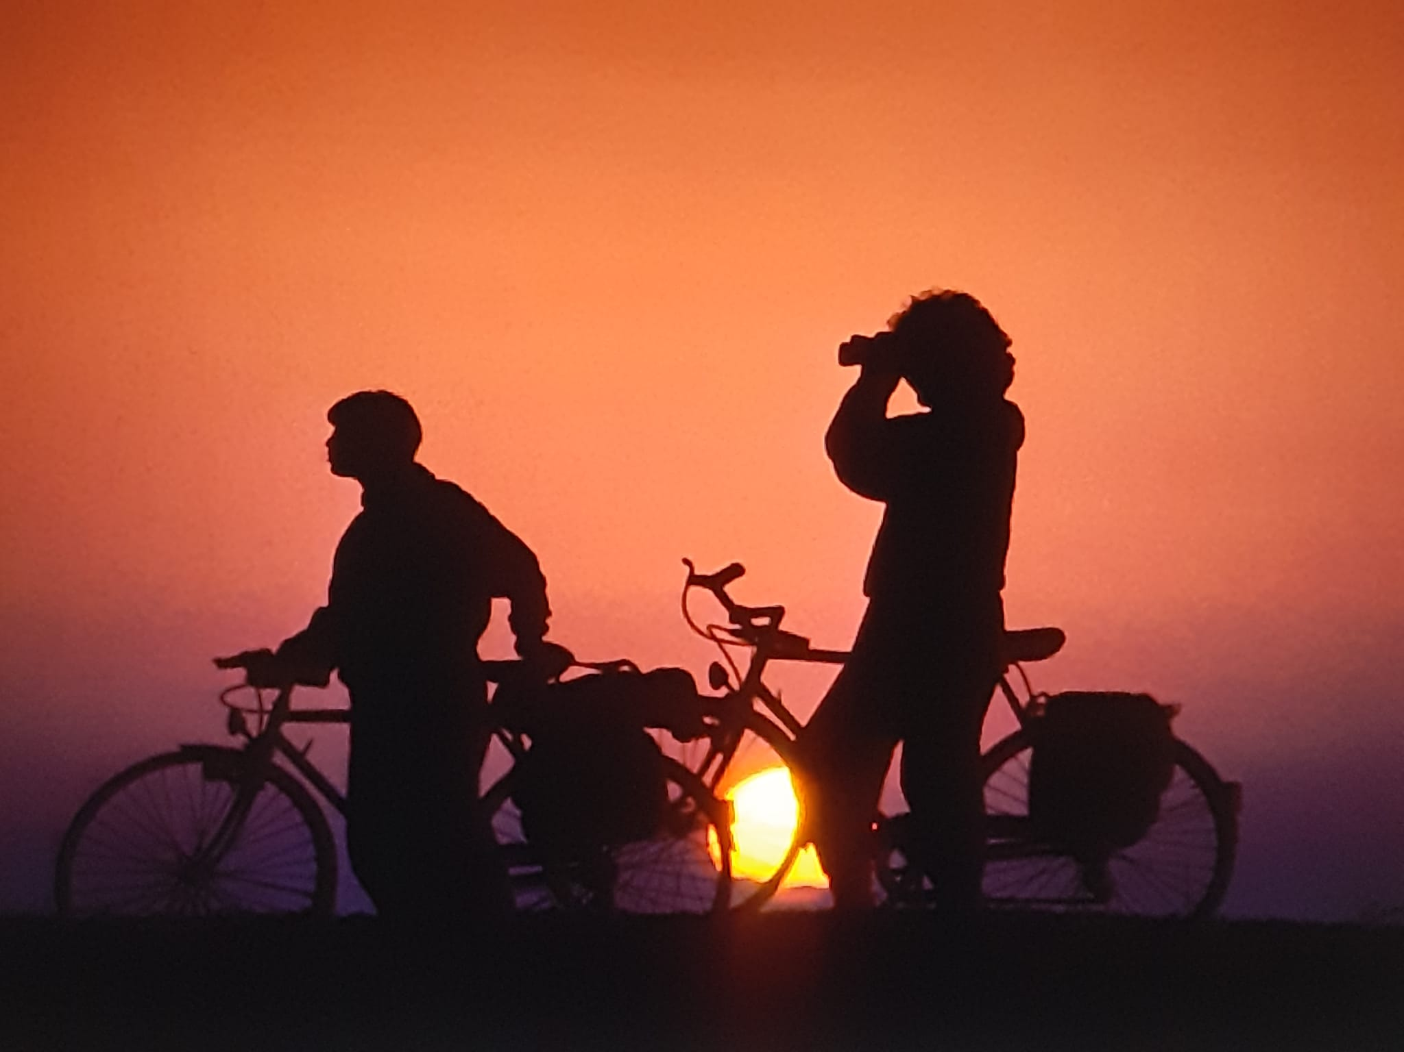
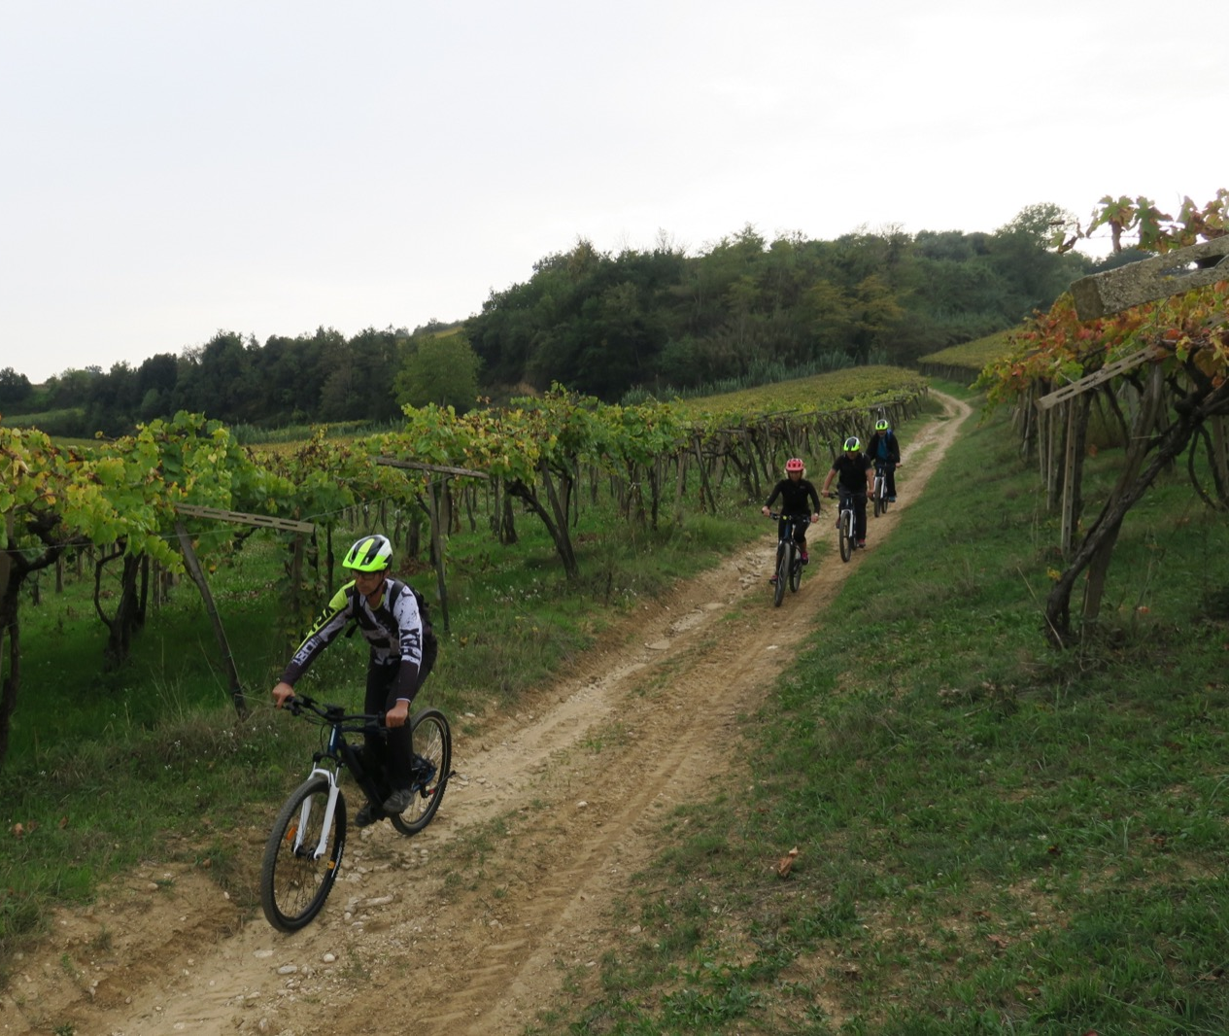
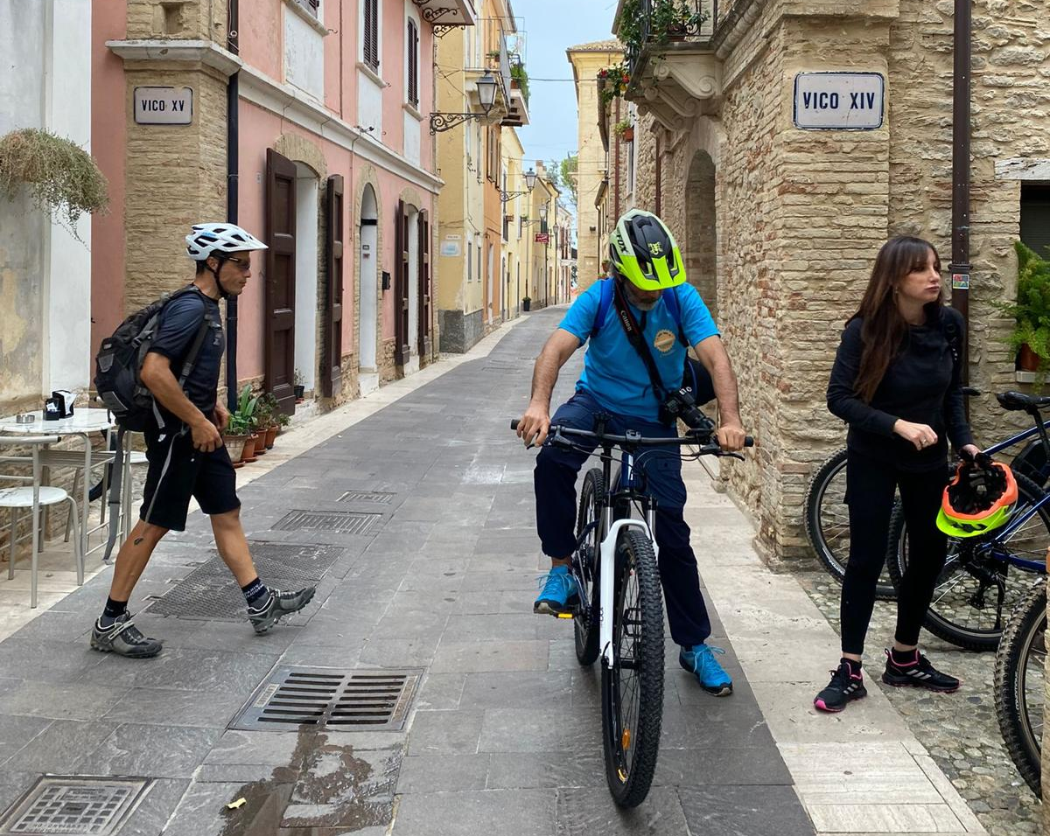
Natural cycling routes

Slide 6
Natural cycling roads, secondary roads with low traffic density, are an important underutilized resource of our territories

Slide 7
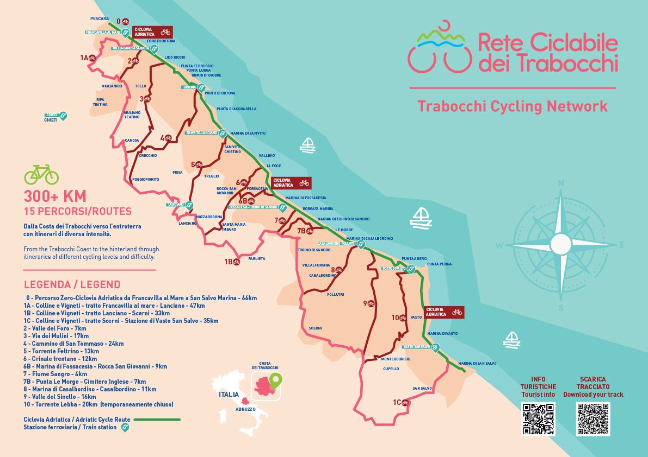
The trabocchi cycle network was inaugurated in September 1991
About 300 km of trails in 7 different rings ( between 30 and 50 km each)
90% on country roads
connection with railway stations
A hybrid orientation system that combines road signs and digital tracks

Slide 8
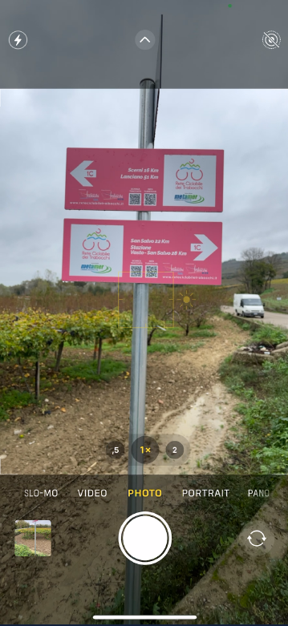
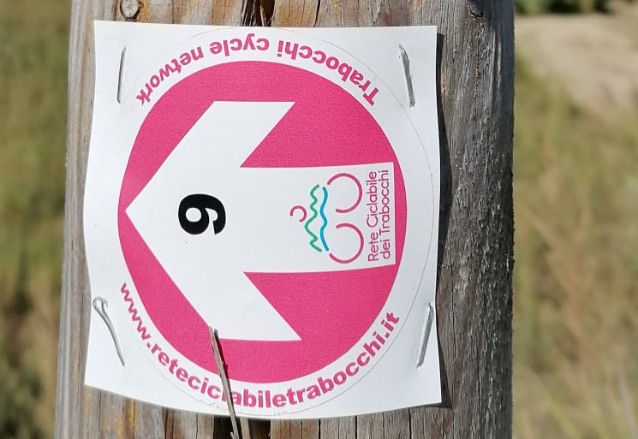
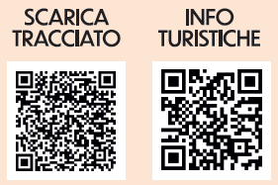
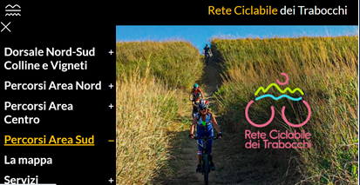
Directional arrows mark the important deviations indicating:
The nr. of the trail
The distance from the main destinations
On the signs two QR codes allow:
Access to the website reteciclabiletrabocchi.it
Access to the digital tracks that transforms your smartphone into an audio and video navigator
The stickers on the poles reassure users that they are on the right track.A dedicated website provides information on the routes

Slide 9
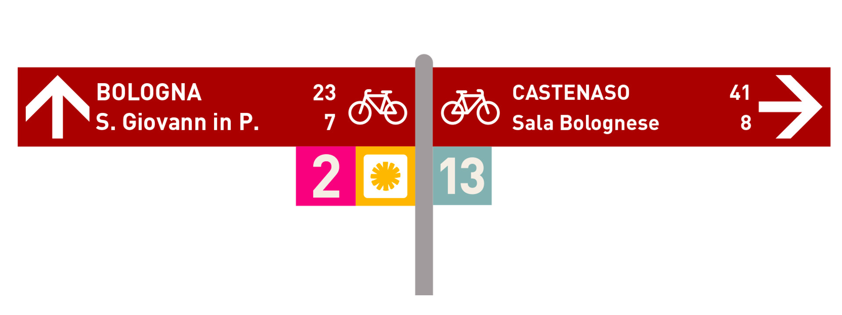
The new signage concept
Direction arrow
Main destination
Distance in km
Bike logo
Next place
Trail number
Trail logo

Slide 10
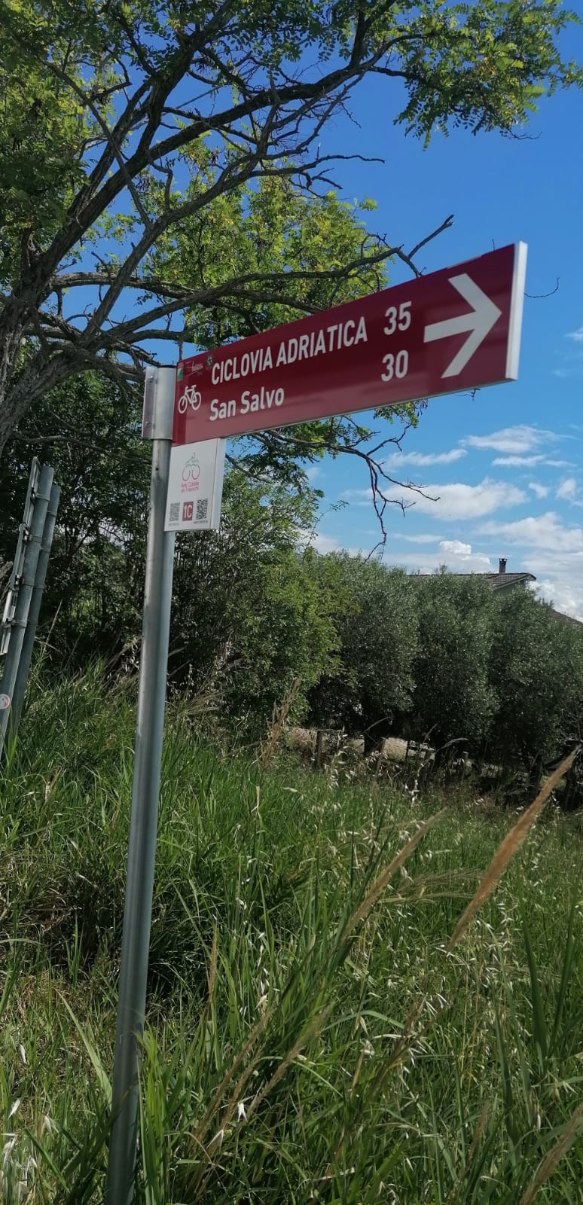
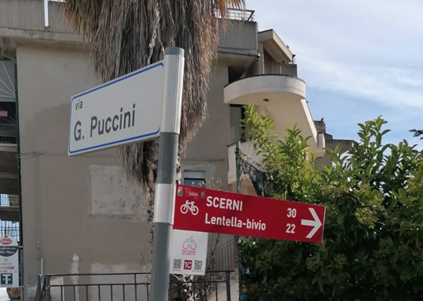
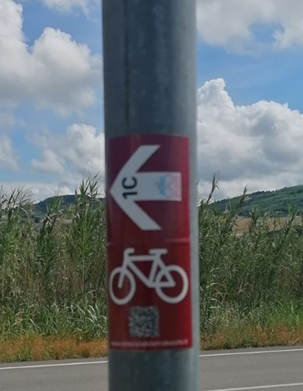

Slide 11
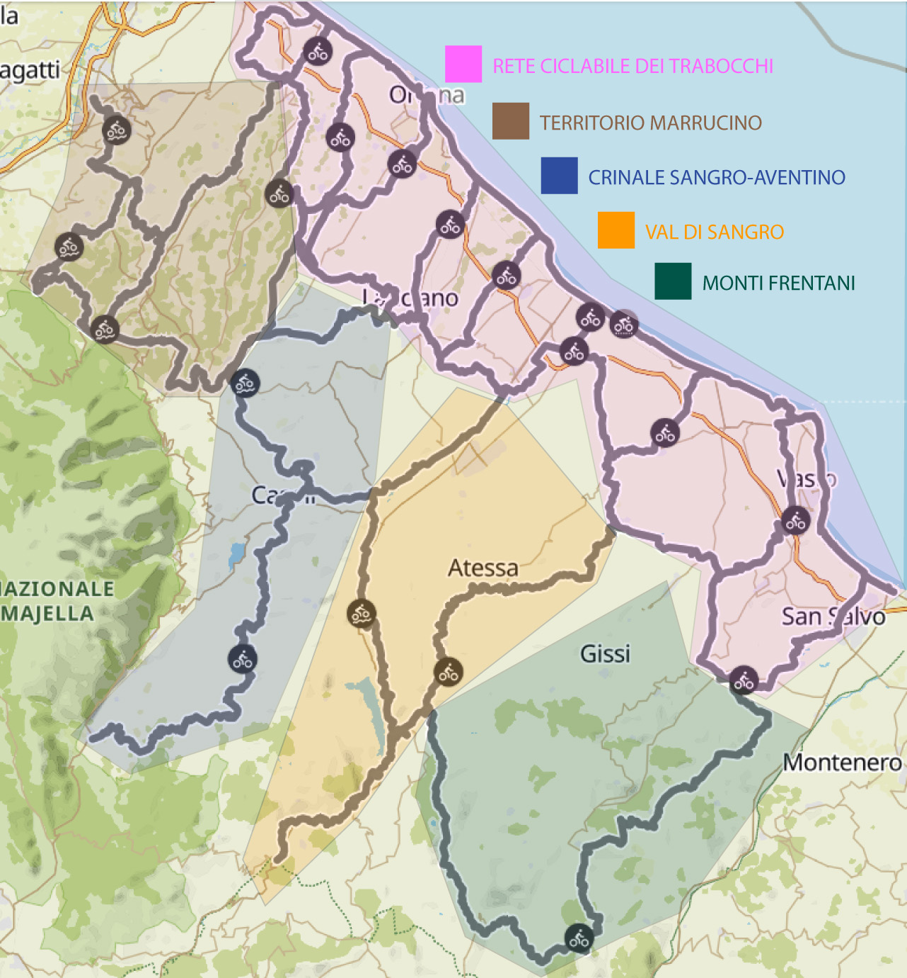
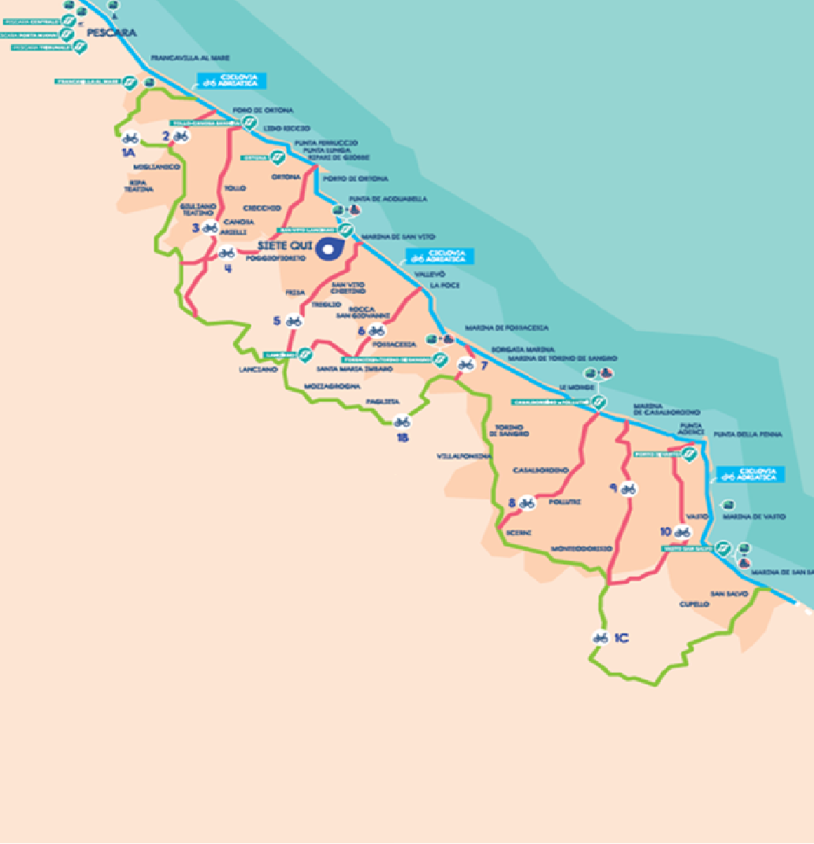
Val di Foro - Majella
Val di Sangro – Alto Sangro
Trigno-Sinello Agnone
Currently the cycle network is extending to the whole province

Slide 12
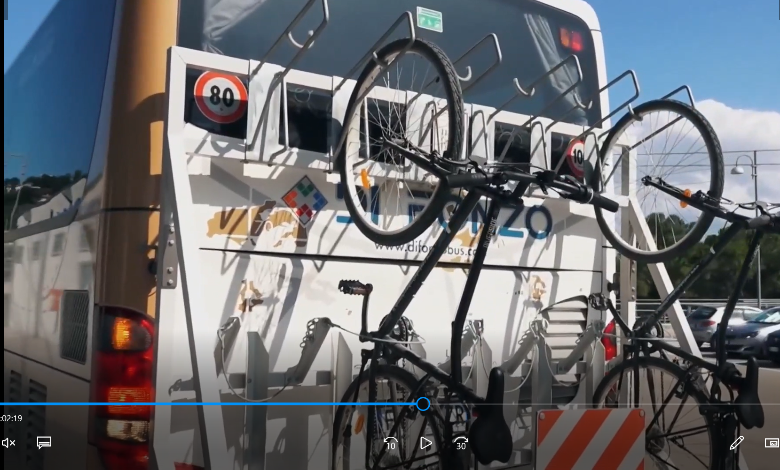

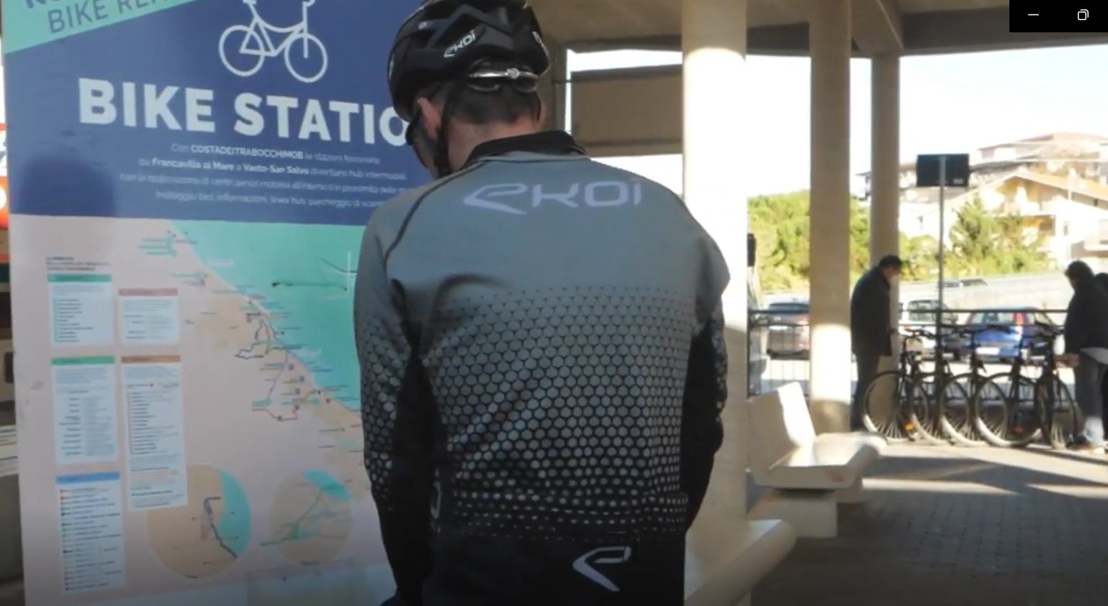
Bike-bus lines: bus lines equipped with bike racks to reach the towns on the hills from the coast;
Bike stations: Train stations on the coast where, if you have the train ticket, you can rent a bike to go to the beach at a very low price;
Intermodality map: digital and paper information to explain how to move in the area without using the car.

Slide 13
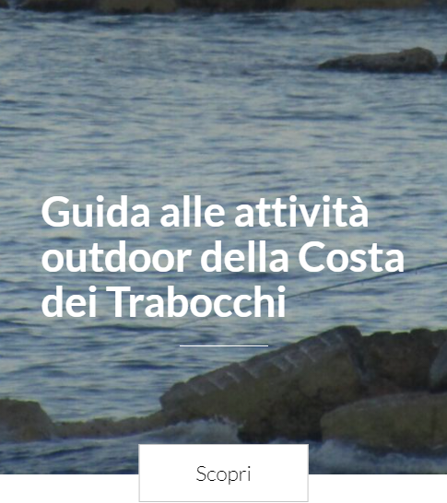
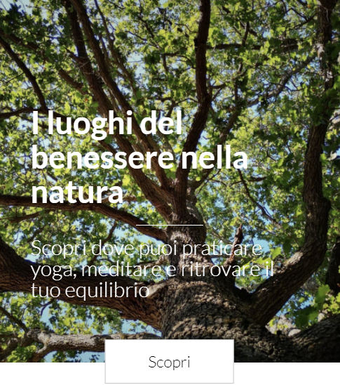
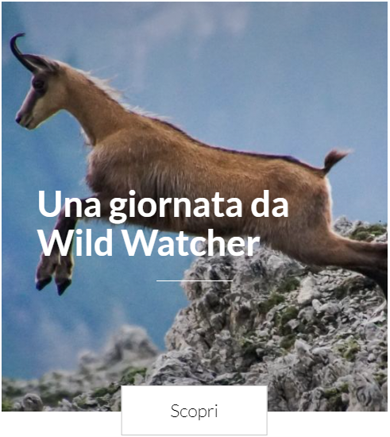
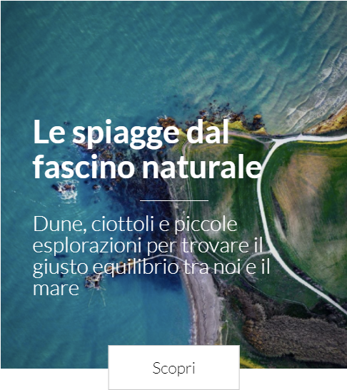
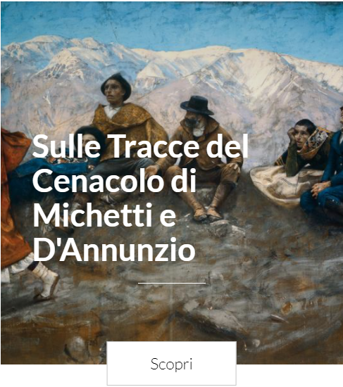
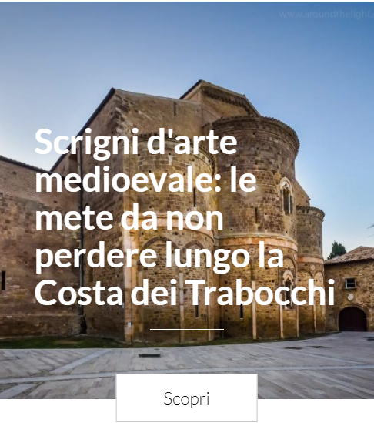
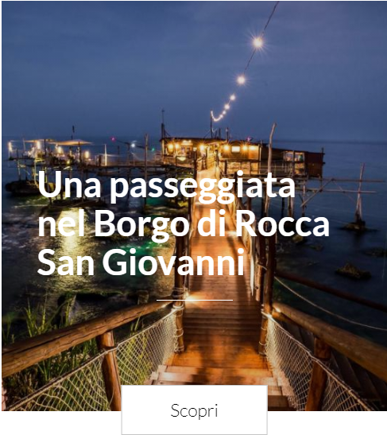
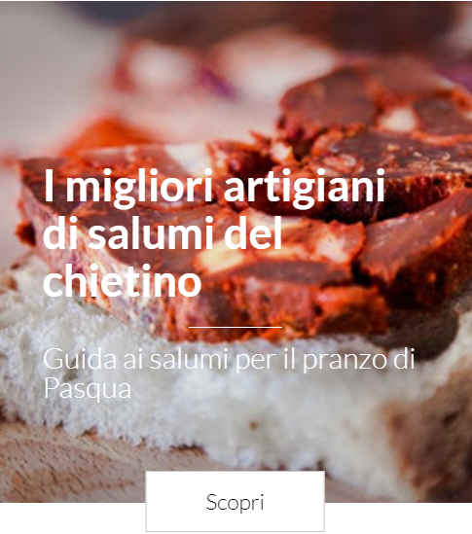
A digital ecosystem to connect the local tourist offer

Slide 14








DIGITAL ECOSYSTEM
278 articles published
The LAG provides to local “work groups” free use of the digital ecosystem infrastructure and training to build tourist information portals
There are two types of portals:
Geographic portals (provide information about a specific territory)
Thematic portals (concerning a specific theme of tourist use)
76 routes
14 stories
193 locations described and mapped out
138 events published
30 actors involved
15 digital portals 26 registered editors
Social Media:
Facebook & Instagram

Slide 15
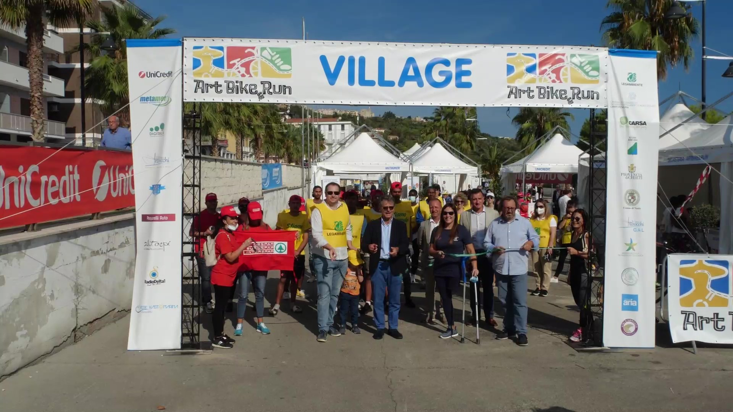

Slide 16
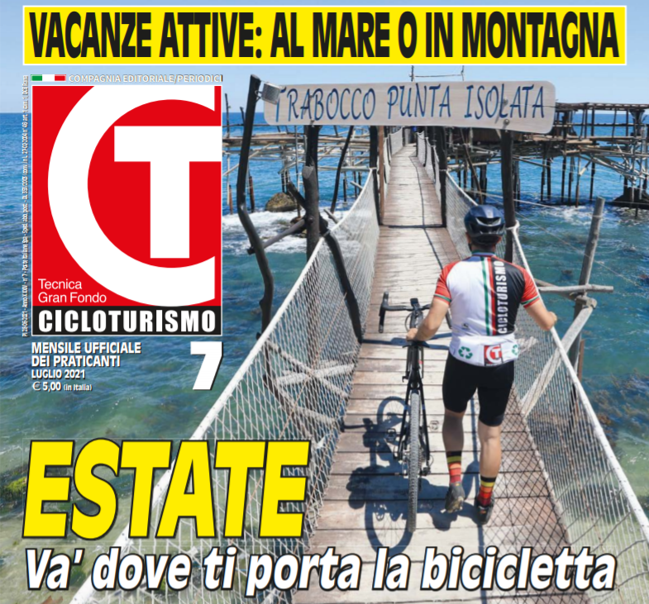
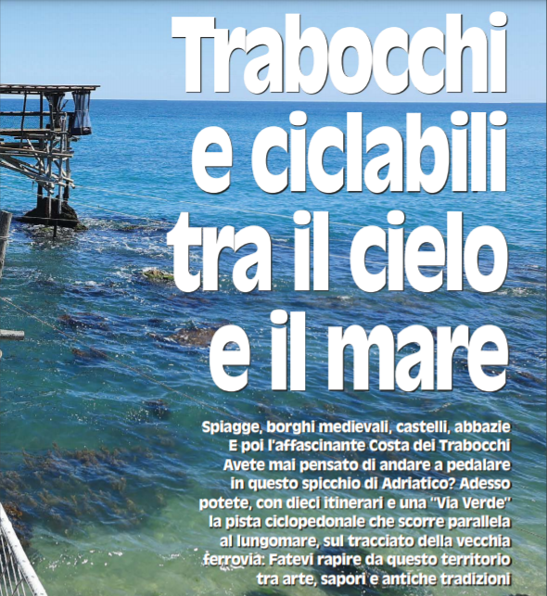

Slide 17
Ricevi il percorso e gli enigmi
Scoprila tua rotta con l’aiuto del capitano K
Goditi le bellezze del territorio
Conosci un produttore e assaggia il suo spuntino

Slide 18
