Slide 1
The long-term vision for rural areas & the Rural Pact
European Rural Pact Support Office
Version: March 2024
Notes:
Dear colleague from the Rural Pact
This presentation provides information about the long-term vision for EU’s rural areas (Rural Vision) and the Rural Pact.
You can use and modify these slides at your convenience as they aim to help you build an understanding, but also to prepare your presentations when introducing the Rural Pact.
Each slide has notes that provide further explanation of the content included in each slide.
We hope you find them useful!
Rural Pact Support Team.

Slide 2
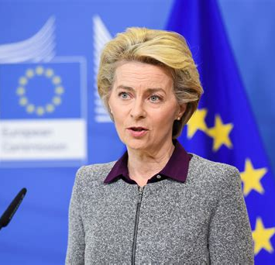
The long-term vision for EU’s rural areas
“
Rural areas are the fabric of our society and the heartbeat of our economy.
The diversity of landscape, culture and heritage is one of Europe’s most defining and remarkable features.
They are a core part of our identity and our economic potential. We will cherish and preserve our rural areas and invest in their future.
European Commission President Ursula von der Leyen
Notes:
Rural areas and their citizens are crucial for the future of Europe.
They are essential for food security, sustainability and social cohesion, and Europe cannot afford to have empty rural areas, as cities would also suffer.
To support rural areas adequately, changes are needed starting at the European level and multi-actor collaboration and commitments to act at all level.
Recognising the importance of rural areas, European Commission President Ursula von der Leyen launched the Rural Vision in July 2019.
This vision recognises the key role that rural areas play in shaping Europe's future and highlights that urgent challenges remain. The rural vision aims to provide a long-term plan to support and develop rural areas, ensuring that no one is left behind in the process.

Slide 3
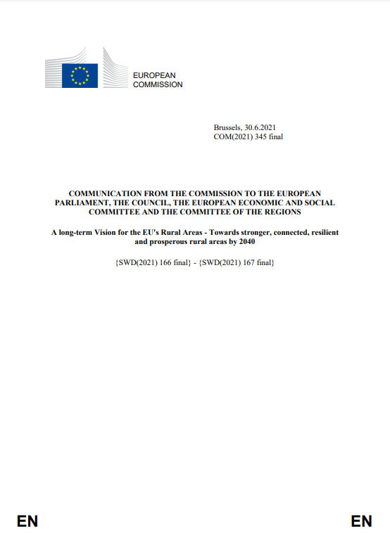
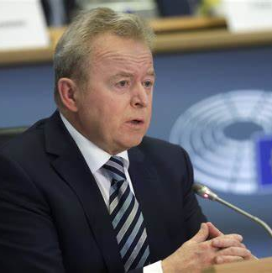
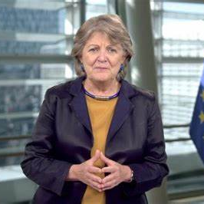
The long-term vision for EU’s rural areas
Vice-president of EC
Demography & Democracy
Dubravka Šuica
Communication from the EC
(June 2021)
Commissioner (Agriculture)
Janusz Wojciechowski
Commissioner (Cohesion and reforms)
Elisa Ferreira
Notes:
The EU launched a reflection with all actors across Europe to draw the common ambitions to achieve for rural areas. This process was coordinated by the vice-president Šuica (Democracy and demography), with Commissioners Wojciechowski (Agriculture) and Ferreira (Cohesion and reforms) as lead and co-lead.
The process resulted in the publication of the Communication from the EC on the long-term vision for EU's rural areas in 2021. https://eur-lex.europa.eu/legal-content/EN/TXT/?uri=CELEX%3A52021DC0345
Since the adoption, there has been constructive dialogue with EU institutions and bodies.
The Communication has triggered political reactions from the Council of the EU, the European Parliament, the Committee of the Regions, the Economic and Social Committee who reacted positively to the Communication.

Slide 4
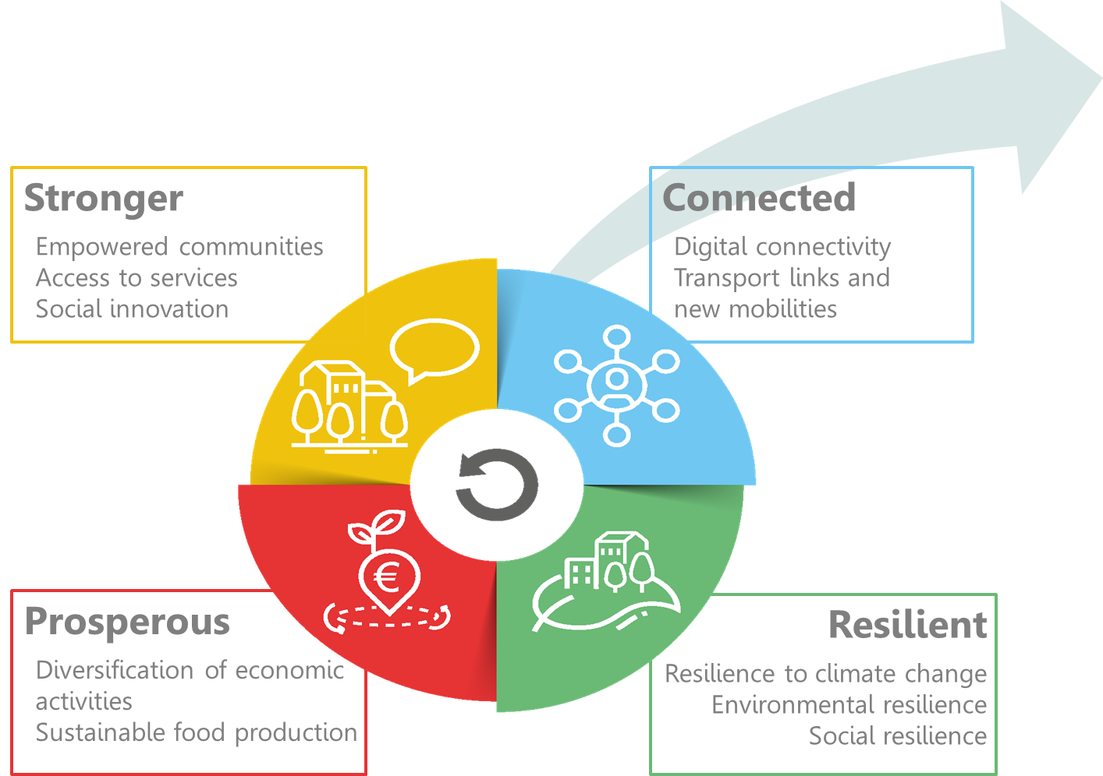
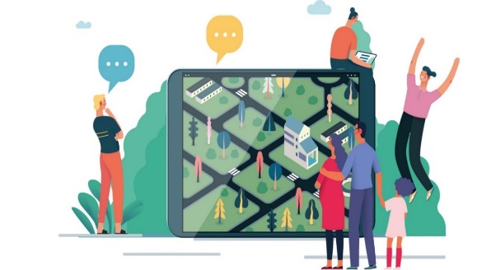
The rural vision by 2040
Shared goals for 2040
Rural action plan (EC)
&
Rural Pact (everyone)
Notes:
The long-term vision is a communication from the European Commission. It prepares the ground for future action but does not bring new funds. For now, stakeholders have to use existing policies and funds, as they have been agreed by the European Parliament and the Member States in the Council, before the adoption of the rural vision.
This vision brought together the common aspirations of Europeans on how they would like rural areas to be in the future: stronger, connected, resilient and prosperous.
The communication proposed two main ways to implement this vision:
The Rural action plan, which is what the European Commission proposes to do, starting from 2021.
The Rural Pact, which is about joining forces with all national, regional and local governments and stakeholders.

Slide 5
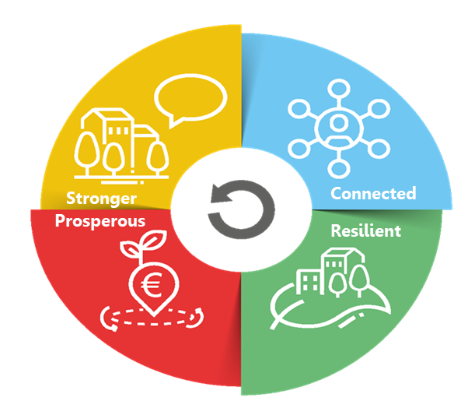
The long-term vision for the EU’s rural areas
LONG-TERM VISION FOR RURAL AREAS
10 SHARED GOALS FOR 2040
Attractive spaces, developed in harmonious territorial development
Engaged in multi-level and place-based governance
Providers of food security, economic opportunities, goods and services for wider society
Dynamic communities focusing on well-being
Inclusive communities
Flourishing sources of nature
Fully benefiting from digital innovation
Entrepreneurial, innovative and skilled people
Lively places equipped with efficient, accessible and affordable public and private services
Places of diversity
Notes:
The vision set 10 shared goals to be achieved by 2040 and cover a wide variety of thematic areas.
The vision exemplifies the need to think strategically about rural areas in an integrated way to be able to respond to the needs and opportunities of rural areas.
The vision aims to address the ambitions, needs and demands from all citizens. It includes farmers and their families, other businesses and people working in rural areas (many not involved in the agri-food and forestry sectors), as well as cities and towns that find mutual benefits with rural areas.
To achieve all the goals of the vision, it is absolutely necessary to broaden the range of stakeholders involved in rural development, including public authorities and policy makers, civil society involvement, academia, citizens and businesses.

Slide 6
The long-term vision for the EU’s rural areas
LONG-TERM VISION FOR RURAL AREAS
10 SHARED GOALS FOR 2040
EU RURAL ACTION PLAN
9 Flagship initiatives
Rural revitalisation platform
Research and innovation for rural communities
Sustainable multimodal mobility best practices for rural areas
Rural digital futures
Support rural municipalities in energy transition and fighting climate change
Climate action in peatland through carbon farming
EU mission : a soil deal for Europe
Social resilience and women in rural areas
Entrepreneurship and social economy in rural areas
Connected
Prosperous
Resilient
Notes:
The Rural action plan contains 30 actions: 24 thematic actions and 6 horizontal actions to support implementation and improve governance.
The thematic actions are structured around the four blocks of action of the vision. They include:
9 flagships: these are bigger initiatives or groups of initiatives.
And 15 accompanying actions: these are more specific things, such as organising networking for LEADER and smart villages, or conducting specific studies.
The big novelty is that these actions involve 14 different Commission departments (like ministries) and the Commission organises coordination between them.

Slide 7
The rural action plan: 24 thematic actions
Rural revitalisation platform launched
Networking on mobility for rural communities under SMARTA-NET
Rural energy communities advisory hub (RECAH)
27 municipalities received technical assistance
Guidance for all
Entrepreneurship and social economy (SE)
European social economy action plan
Good practices for rural under “Transition pathway for proximity and social economy”
Funding for consortia in SE in rural areas
Research and innovation for rural communities
€253 million in Horizon EU
European Startup village forum launched
Urban mobility framework published & urban mobility plans being updated
Rural Digital Futures
€23.5 billion invested in connectivity
Pilot on digital education in remote areas “Learning from the extremes”
Rural digital indicators in digital decade reports
Certification of Carbon removals
Networking for LEADER (EU CAP Network) and Smart villages (SmartRural21 & 27)
EU mission: A soil deal for Europe (R&I calls)
Education for youth
WG education & values
Rural under school education platform & online teacher community
Study on land-use for sustainable agriculture launched
Social resilience and Women in rural areas
European care strategy (2022) highlighting rural
Study on working conditions of farm employees
Broadband competency office network renewed
Toolkit for producer groups in GIs
Youth:
Inclusion in ERASMUS
EU youth Strategy Goal 6
Study on rural youth opportunities for learning
R&I projects for digitalisation of agriculture
Thematic group for forest-dominant municipalities
Notes:
This slide presents some of the key achievements under the EU Rural action plan between 2021-2023.
All actions are ongoing or completed, some even continuing after what had been initially planned has been done.
This slides shows the wide variety of themes that are covered by the rural vision and the involvement of 14 Commission departments.
Even if the Rural Vision did not come with new funds, a substantial amount of money coming from EU funded programmes has been targeted to rural areas, like for example:
- research and innovation (253 million for over 60 projects).
- the flagging of €23.5 billion to improve connectivity, mostly in areas where markets fail to deliver (i.e. rural areas).
- technical assistance provided to support networking activities for LEADER and smart villages, creating energy communities, a mobility network or social economy consortia in rural areas.
- technical assistance to conduct studies or assemble working groups on rural youth, or working conditions of farm employees, or forestry, and improve our understanding of what is happening in rural areas.
Some of these actions are more geared to creating opportunities for rural citizens, like making sure their needs are taken care of in revised urban mobility plans or inviting Member States to act in their areas of competence such as care or digital skills, through Council recommendations.
The Commission report on the rural vision (March 2024) and the rural vision website provide more information on each of the actions.

Slide 8
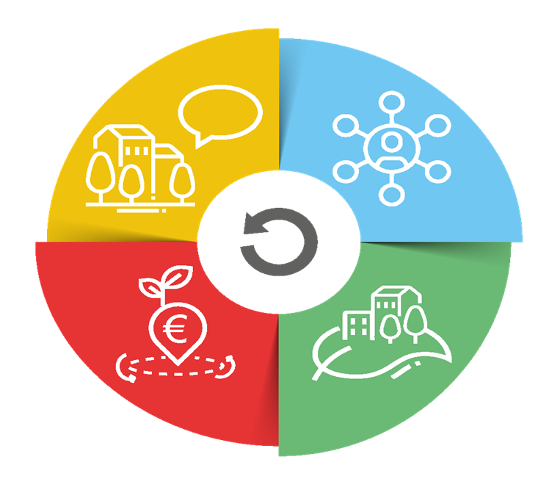
The long-term vision for the EU’s rural areas
LONG-TERM VISION FOR RURAL AREAS
10 SHARED GOALS FOR 2040
EU RURAL ACTION PLAN
6 Horizontal actions
The EU Rural Observatory (find more)
Improved Statistics on rural areas
Functional Rural Areas
Rural Proofing at EU level
Rural toolkit on EU funding (find more)
Rural Pact
Stronger
Connected
Prosperous
Resilient
Notes:
Similarly, all Horizontal actions are also launched.
1. (First action: the EU Rural Observatory)
First, the Rural Observatory which is coordinated by the Joint Research Centre (JRC) of the European Commission. It was born with one clear ambition: give everyone access to essential data about rural areas to foster a better understanding of their circumstances and diversities, hence increasing the analytical capacities for evidence-based policies. A hundred indicators from multiple sources are included, covering economic, social and environmental dimensions at different levels of granularity. Please, browse through it if you have not done so yet.
Website: https://observatory.rural-vision.europa.eu/?lng=en&ctx=RUROBS
2. (Second action: Statistics on rural areas)
Before making them accessible in a centralised platform, data needs to be collected. To understand the complexity of the issues at stake more and better-quality data on rural areas are needed. This is why the European Commission has launched a second action, working with the statistics departments of Member States on improving statistics on rural areas. A new regulation is being discussed on population statistics, and experimental datasets on healthcare and education facilities have been published. All this to make the Rural Observatory even more comprehensive.
3. (Third action: definition of functional rural areas)
A third action is the application of the Functional Areas concept to the rural environment. Functional Areas seek to go beyond administrative boundaries through a better understanding of, population and service flows, among other things. A first methodology of Functional Rural Areas has already been prepared by the Commission’s Joint Research Centre and DG REGIO. Meanwhile, the Commission, and the World Bank are working on a pilot project on Functional Areas, combining cities, towns and suburbs as well as rural areas. Indeed, the rural-urban space is understood as an interlinked continuum.
4. (Fourth action: rural proofing at EU level)
The European Commission are promoting the mainstreaming of rural areas concerns and issues — hence our fourth action, rural proofing. It is about taking a rural lens to new policy making. In November 2021, the European Commission updated the guidelines that all Commission services use to build new initiatives. Services are encouraged to explore whether initiatives will have differential impacts on territories, and if so, ensure mitigation measures. For legislatives initiatives, Territorial Impact Assessment is the procedure in place. The European Commission has also run a thematic group on rural proofing at national and regional levels, so to get to rural-proof national legislation too.
5. (Fifth action: toolkit on EU funding)
The European Commission has developed a toolkit oriented to practitioners on how to make full use and combine the various EU funds to support rural projects, beyond CAP and Cohesion Policy. The toolkit has been launched on 6 February 2024, after having been discussed in stakeholder events in June and October 2023, with the support of the JRC.
Attached to the toolkit are various tools such as STRAT-BOARD, or the Handbook on territorial development strategies, also prepared by the Joint Research Centre with a focus on Cohesion Policy.
6. (Sixth action: Rural Pact): To propose and facilitate the Rural Pact, which we detail in the next slides.

Slide 9
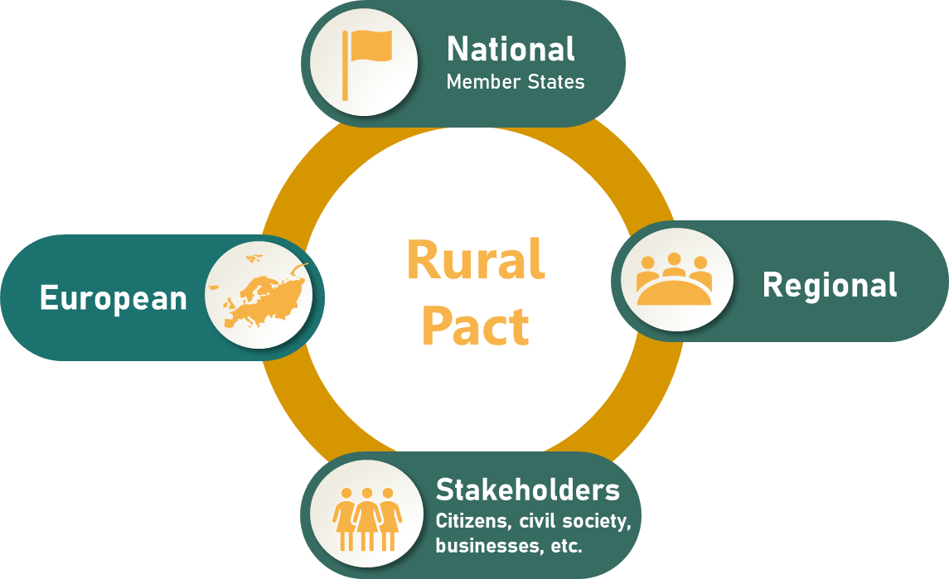
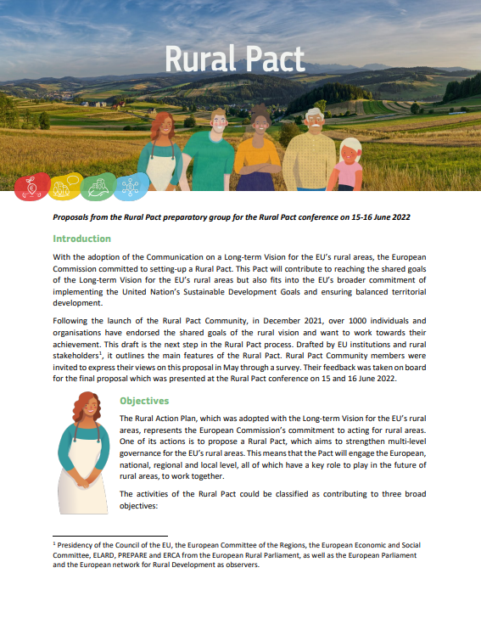
The Rural Pact
Participatory process
What is the Rural Pact ?
The Rural Pact is a formal space and framework to boost cooperation between national, regional and local governments, civil society organisations, businesses, academics and citizens to act towards the shared goals of the rural vision.
Proposal endorsed
Rural Pact Conference (15-16 June 2022)
Notes:
The European Commission set up the Rural Pact in December 2021, together with the Rural Pact community. It has then worked with the community and a Rural Pact preparatory group and come up with a proposal that was endorsed at the Rural Pact Conference on 15-16 June 2022.
The Rural Pact is a formal space and framework to boost cooperation between national, regional and local governments, civil society organisations, businesses, academics and citizens to act towards the shared goals of the Rural Vision.
It is this diverse community that will seize this opportunity for a European rural agora for discussion and interaction. The Rural Pact belongs to all actors willing to make the difference in EU’s rural areas and aims to act as a network for governance of rural issues, complementing the Commission Rural Action Plan, amplifying rural voices and giving them direct access to EU level.

Slide 10
The Rural Pact - Objectives
Amplifying rural voices and bringing them higher on the political agenda
Structuring and enabling networking, collaboration & mutual learning
Encouraging and monitoring voluntary commitments to act for the vision
Join the Rural Pact Community! Become a member of the Rural Pact | Rural Pact Community Platform (europa.eu)
Rural Pact Proposal: https://agriculture.ec.europa.eu/system/files/2022-07/rural-pact-proposal_en.pdf
Notes:
The Rural Pact has three objectives:
Amplifying rural voices by bringing up key rural concerns in the policy agendas and making these voices acted upon.
Networking, collaboration & mutual learning
Commitments to act. These are specific actions that individuals and organisations submit to the Rural Pact and that they commit to implement to contribute to achieve the rural vision. For instance: A rural municipality has committed to implement a Renewable energy community to support the green transition of the area, involving and mobilising 200 citizens and businesses.

Slide 11
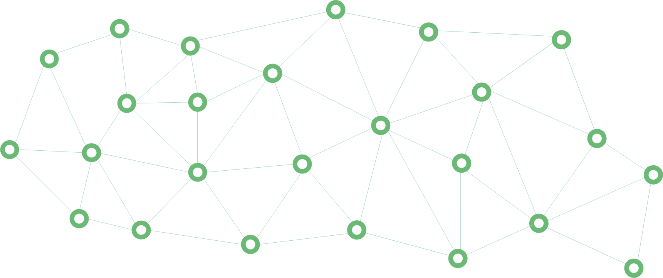
The Rural Pact Community Members
+2350
Rural Pact Community Members by Feb 2024
Public authorities
Businesses
Academic and R&I
+120
Commitments to act
Civil Society
Individuals
Participating in the Pact = Committing to act for one or more of its objectives
Join the Rural Pact Community! Become a member of the Rural Pact | Rural Pact Community Platform (europa.eu)
Notes:
There are five types of participants in the Rural pact which are : public authorities, civil society organizations, businesses, citizens, as well as academic research bodies. These categories encompass everyone involved in rural development.
It is important that all stakeholders register as members of the Rural Pact community in order to participate: Join the Rural Pact Community! https://ruralpact.rural-vision.europa.eu/become-member

Slide 12
Rural Pact Support Office
The Rural Pact
Rural Pact Coordination Group
Rural Pact Support Office
Informal group steering the Rural Pact process
Three-year mandate
Learn more here
Provide facilitation services to the Rural Pact community
Networking and information
Build synergies with networks and governing bodies
Evaluate needs of the RP community and support its work
Notes:
How the Rural Pact is being coordinated ?
- On the one hand, the Rural Pact Support Office (RPSO) coordinates and implements the networking activities of the Rural Pact and its community with the ambition to achieve the Rural Pact objectives and the Long-term vision for EU’s rural areas (LTVRA). The RPSO builds synergies and complementarities with all relevant EU policy networks and initiatives working on and for rural development to jointly contribute to stronger, connected, prosperous and resilient rural areas in Europe, including the CAP Network, Broadband Competence Office Support Facility, Territorial Agenda 2030, Preparatory Action Smart Rural 21 & 27, or with the Talent Booster Mechanism.
On the other hand, a Rural Pact Coordination Group, representative of the participants of the Pact, has been set up. This is a special group of the European Commission which steers the Rural Pact process with a 3-year mandate. The lead DG is DG Agriculture and Rural Development, and the co-lead DG is DG Regional and Urban Policy. The Rural Pact Coordination Group overlooks the RPSO tasks and is be able to give strategic orientations by making proposals to the European Commission.
The Rural Pact Coordination Group meets twice a year, facilitated by the RPSO.

Slide 13
The Rural Pact Support Office
Good Practices
Policy Action Labs Policy Forums
Animation Networking
Good Practice Webinars
Rural Pact
Support Office
Website & Social Media
RP Coordination Group
Magazine, Newsletters
Commitments to act
Notes:
The Rural Pact Support Office
The Rural Pact Support Office (RPSO) coordinates and implements the networking activities of the Rural Pact and its community with the ambition to achieve the Rural Pact objectives and the Long-term vision for EU’s rural areas (LTVRA). The RPSO is tasked for the next years to:
animate the members of the community as well as encourage and promote commitments to act; the RPSO is responsible for ensuring that the Rural Pact community is engaged and makes commitments to fulfil the ambitions set out in the LTVRA. The RPSO will interact with stakeholders who committed to the Rural Pact to evaluate their needs and accompany them as well to attract new members.
identify and promote good practices that can inspire action in rural areas;
organise webinars for capacity building and peer learning, as well as high-level policy events;
support the meetings of the Rural Pact Coordination Group;
keep the community informed through the website, social media channels, the monthly newsletter and the annual Magazine.

Slide 14
Main Events in 2023
Policy Labs
Good Practice Webinars
Taking action to tackle rural depopulation, Brussels, Belgium (29 June)
Online - EU funds paving the way to the rural vision (14 December)
Fostering social entrepreneurship in rural areas through local action (11 May)
Strengthening digital skills of rural people to benefit from the digital era (8 June)
Rural areas in the energy transition (24 October)
Enhancing access to health services in rural areas (30 November)
All events | Rural Pact Community Platform (europa.eu)
Upcoming events: https://ruralpact.rural-vision.europa.eu/events/upcoming
Notes:
Find out information about the main events organised by the RPSO in 2023.

Slide 15
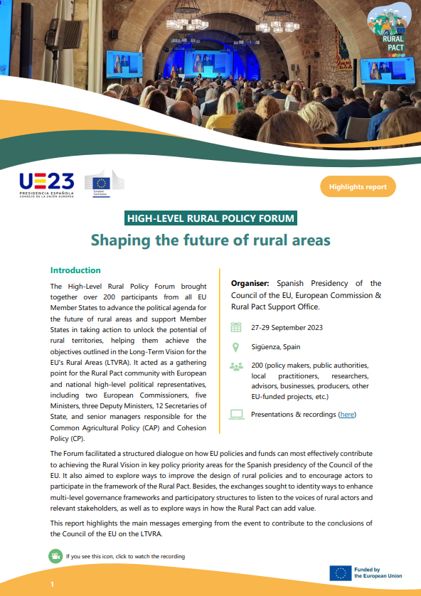
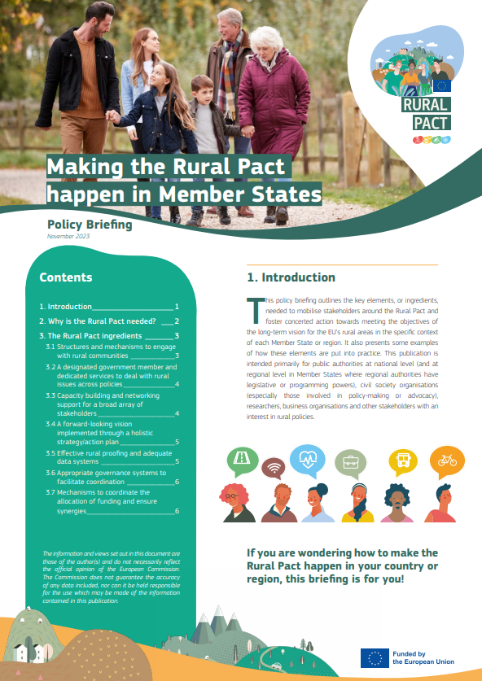
Main Events in 2023
High level Rural Policy Forum
Shaping the future of rural areas
(27-29 September), Sigüenza (Spain)
Organised by Spanish presidency & European Commission with the support of the RPSO
https://rural-vision.europa.eu/events/shaping-future-rural-areas-2023-09-27_en
Notes:
One of the major event of 2023 was the high-level rural policy forum “Shaping the future of rural areas”, that was co-organised by the Spanish presidency of the EU Council and the European Commission with the support of the Rural Pact Support Office.
The priority of this event was to bring the national authorities on board and to prepare the ground for Council conclusions on the Rural Vision.
A Policy Briefing on how to make the Rural pact happen in Member States was also prepared as background to help the Member States understand how they can implement the rural pact in practice, based on 7 ingredients.

Slide 16
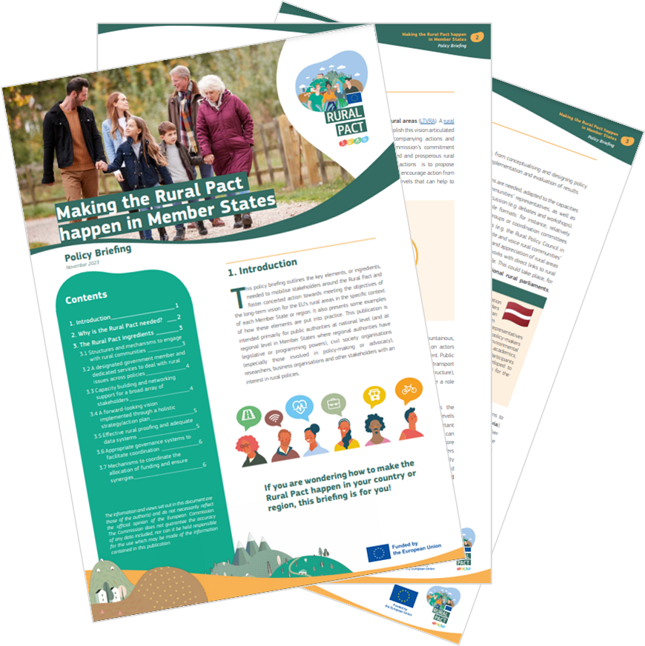
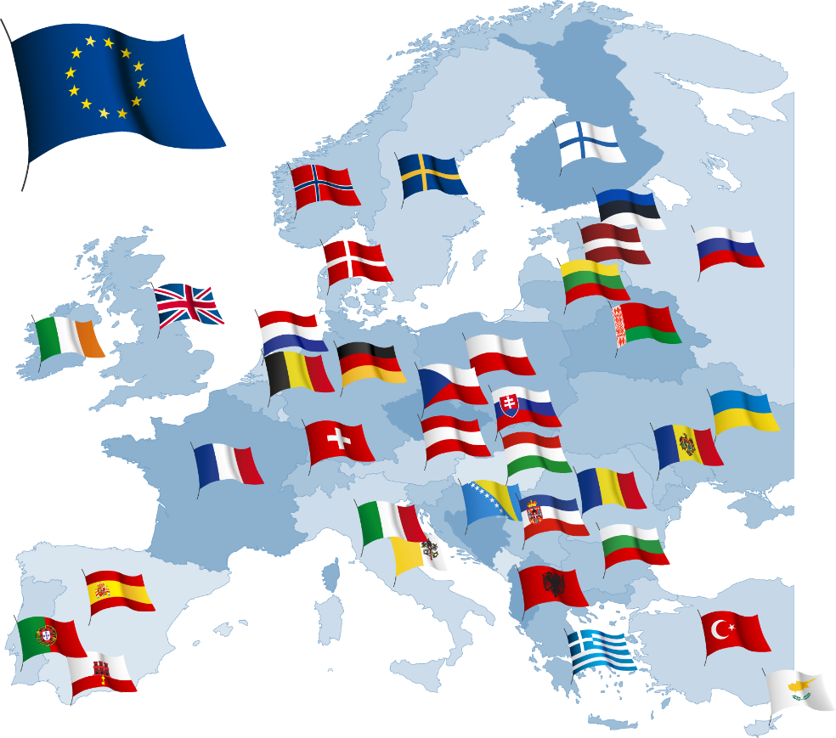
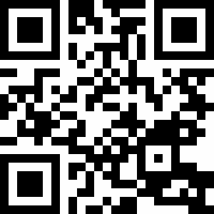
Making the Rural Pact happen in Member States Policy Briefing
Available in 24 EU languages
https://ruralpact.rural-vision.europa.eu/publications/making-rural-pact-happen-member-states_en#section--resources
Notes:
Policy Briefing: to help the Member States understand how they can implement the rural pact in practice, based on 7 ingredients. Read the Policy Briefing in 24 languages:
https://ruralpact.rural-vision.europa.eu/publications/making-rural-pact-happen-member-states_en

Slide 17
Interinstitutional dialogue
Czech Presidency – Lednice declaration + launch of CZ Rural Pact (28 October 2022)
Swedish Presidency – Rural pact Conference in Sweden (3-4 May 2023, Sweden)
Spanish Presidency – High-level rural policy forum (27-29 Sept. 2023, Sigüenza)
Council conclusions (20 November 2023)
French Presidency – GAC Cohesion conclusions on Cohesion report (2 June 2022)
Opinion LTVRA (26 Jan 2022)
Opinion Smart Rural Europe (15 March 2023)
Opinion (23 Mar 2022)
Report (13 December 2022)
Notes:
The work on the Rural Vision and the Rural Pact are contributing to bring issues higher on the political agenda including through dialogue between various European institutions and bodies.
The Committee of the Regions (CoR), the European Economic and Social Committee (EESC) and the European Parliament all adopted their opinions in 2022.
The Council of the European Union, under the Spanish presidency, adopted conclusions on the Vision on the 20th November 2023 during the AGRIFISH Council.
This was prepared through several steps:
The Slovenian presidency held an informal Council debate in autumn 2021.
The French presidency adopted conclusions on the 8th Cohesion report that include a reference to the rural vision.
The Czech presidency has launched its national Rural pact, leading by example and participated in the declaration of Lednice that brings together also the Committee of the regions and the European Parliament.
In May 2023, the Swedish presidency hosted the Rural Pact conference in Uppsala to share best practices and examples on the implementation of the Rural Pact at national level, discuss the multi-level governance for holistic rural development, explore tools and methods for the Rural Pact and examine young people’s involvement and participation in the Rural Pact.
In September 2023, the Spanish presidency of the Council organised a High-level rural policy forum event that had the ambition to prepare the ground for Council conclusions dedicated to the Rural Vision.

Slide 18
Council conclusions unanimously adopted on 20 November 2023
Highlights:
rural areas as key contributors to the EU's economies and societies
the need for a holistic approach to address multifaceted challenges
the need to make sure rural voices are heard
the importance of better connectivity and digital skills
the importance of investments from EU, national, regional and local sources
Next steps:
Calls on the Commission to consider developing the vision into an EU rural strategy, with a comprehensive and flexible approach and relevant indicators
Encourages Member States to further engage in the Rural Pact and develop strategies and actions plans at national, regional and local level for the benefit of rural areas.
PRESS RELEASE: A long-term vision for the EU's rural areas: Council approves conclusions - Consilium (europa.eu)
Notes:
These are a few highlights of the Council conclusions that were unanimously adopted on 20 November 2023.
You can read their press release (link at the bottom)

Slide 19
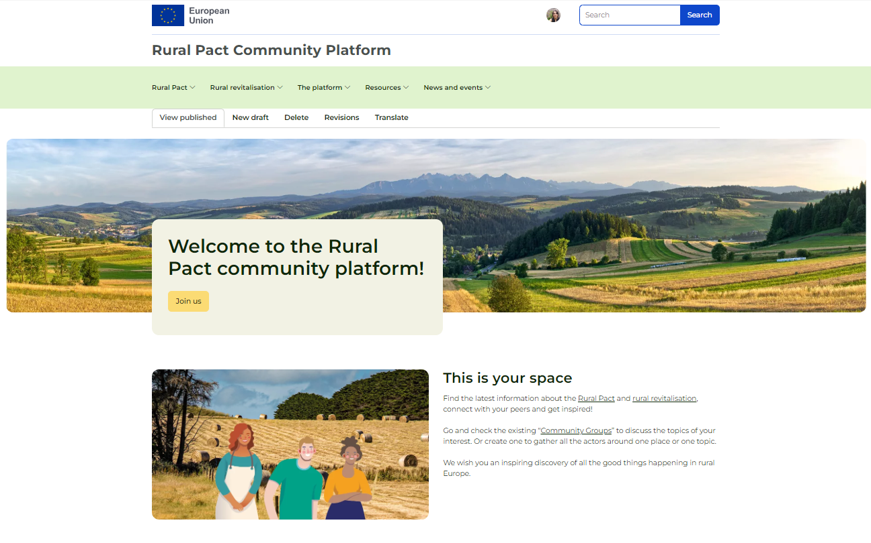
The Rural Pact Community Platform A growing online rural community with a focus on rural revitalisation
+550
Registered members by Feb 2024
Connect with others
Raise your voice
Get informed & inspired
+30
Member States
Become a member of the Rural Pact and platform
Notes:
One of the biggest flagships launched recently is the Rural revitalisation platform, which we have integrated in a broader platform serving all activities under the Rural Pact to integrate things rather than multiply them.
Under this platform you can create your own profile, interact with others in community groups and access resources.
Under resources, you can find good practice fiches.

Slide 20
The Rural Pact Community Platform A growing online rural community with a focus on rural revitalisation
What is in it for you?
Connect with peers
Join the Community Groups
Get inspired from good practices
Receive invitations to participate in events
Be informed from publications, news & events
Commit to act for rural areas
Receive the monthly newsletter
Become a member of the Rural Pact and platform
Notes:
Rural stakeholders can find many benefits in the Rural Pact Community Platform, including:
Connect with peers
Join exchanges in the Community Groups
Find out more from good practices
Be invited to the Rural Pact events
Be informed from publications, news & events
Commit to act for rural areas
Receive the monthly newsletter

Slide 21
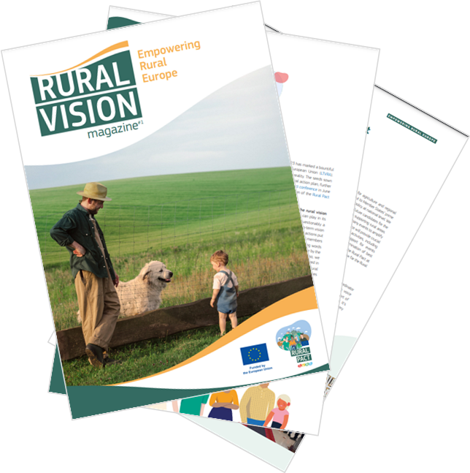
Rural Vision Magazine
This first edition of the Rural Vision Magazine provides you with stories and information to inspire and drive progress in implementing the Rural Vision.
Rural Vision Magazine | Edition 1 | Rural Pact Community Platform (europa.eu)
Notes:
This first edition of the Rural Vision Magazine provides you with stories and information to inspire and drive progress in implementing the Rural Vision.

Slide 22
What’s in the Rural Vision and the Rural Pact for you? What can you do?
What’s in it for you? | What can you do?
Momentum created at EU level for more and better targeted action for rural areas | Use this momentum in your respective countries, regions and local areas to ask for improvements
Rural Pact Coordination Group: a new governance body to steer the Rural Pact, connecting institutions and networks (thematic, sectoral, rural) acting for the benefit of rural communities across Europe | Use your membership in networks to make your ideas better known and contribute to positive outcomes at EU and national levels
Rural Pact Community Platform to learn from and exchange with others & create your own online space (group) to share information Rural Pact community Newsletter, to be informed about news, events, good practices, publications, funding etc. | Engage and share to enrich collective knowledge and help ideas for actions to emerge – contact us at info@rural-pact.eu to share your news, events, good practices, publications & more
Increased visibility for what actors do & ideas of initiatives to take (Commitments to act) | Get inspired and inspire others: promote what you do in the Pact context to create critical mass
Tools created by the EU Rural Action Plan: EU Rural Observatory (access to data), EU toolkit on Rural Funding (help identify the right funding schemes), framework for rural proofing at national, regional and local levels. | Use the tools and tell us how you would like to see them improved (mindful of resources) Encourage national and regional authorities in your country to use these tools or build similar ones
Funding opportunities under various programmes contributing to the EU Rural Action Plan (Horizon EU, ERASMUS+, Single Market etc.) | Stay tuned and apply to benefit! If you find it difficult, help us understand why

Slide 23
Main events in 2024
Policy Labs
Good Practice Webinars
Rural communities tackling climate change (20 March)
Youth participation in policy making (24 April)
Improving rural mobility (June – tbc)
In person: Translating the Rural Pact into action at local levels (22 May 2024)
Online: Rural areas in the policy agenda (October - tbc)
https://rural-vision.europa.eu/events_en
Notes:
Find out information more about the main events organised in 2024 and be invited to participate by:
Becoming a member of the Rural Pact Community Platform: https://ruralpact.rural-vision.europa.eu/become-member_en
Checking the event section of the website: https://ruralpact.rural-vision.europa.eu/events/all_en
Last update 15 February 2024.

Slide 24
Be informed, participate and take action
Steps
1
Join the Rural Pact Community
Form: https://ruralpact.rural-vision.europa.eu/become-member
2
Take action contributing to the vision & share it with us
Form: https://ec.europa.eu/eusurvey/runner/TheRuralPactCommitmentCanvas
Notes:
Steps to become a member of the Rural Pact.
Join as a member of the Rural Pact Community by filling the dedicate Form: https://ruralpact.rural-vision.europa.eu/become-member
Make a commitment to implement a concrete action, project, initiative that contributes to the Rural Pact and share it with us by filling the following Form: https://ec.europa.eu/eusurvey/runner/TheRuralPactCommitmentCanvas

Slide 25
Notes:
Thank you!

