Slide 1
The long-term vision for rural areas & the Rural Pact
Insert name
Name of the organization
Date & Event
Notes:
Dear colleague from the Rural Pact
This presentation provides information about the EU's long-term vision for rural areas and the Rural Pact.
You can use and modify these slides at your convenience as they aim to help you build an understanding but also to prepare your presentations when introducing the Rural Pact. Each slide has notes that provide further explanation to the content included in each slide.
We hope you find them useful!
Rural Pact Support Team.

Slide 2
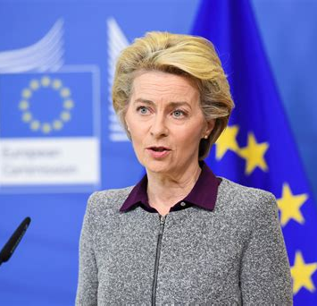
The long-term vision for EU’s rural areas
“
Rural areas are the fabric of our society and the heartbeat of our economy.
The diversity of landscape, culture and heritage is one of Europe’s most defining and remarkable features.
They are a core part of our identity and our economic potential. We will cherish and preserve our rural areas and invest in their future.
President Von der Leyen
Notes:
Rural areas and their citizens are crucial for the future of Europe.
They are essential for food security, sustainability and social cohesion, and Europe cannot afford to have empty rural areas, as cities would also suffer.
To support rural areas adequately, changes are needed starting at the European level and multi-actor collaboration and commitments to act at all level.
Recognising the importance of rural areas, European Commission President Ursula Von Der Leyen launched the Rural Vision in July 2019.
This vision recognises the key role that rural areas play in shaping Europe's future and highlights that urgent challenges remain. The rural vision aims to provide a long-term plan to support and develop rural areas, ensuring that no one is left behind in the process.

Slide 3
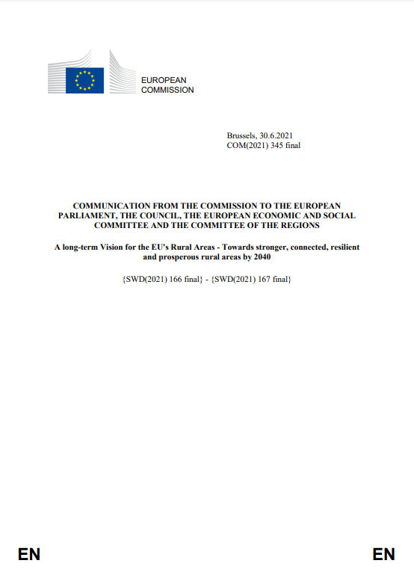
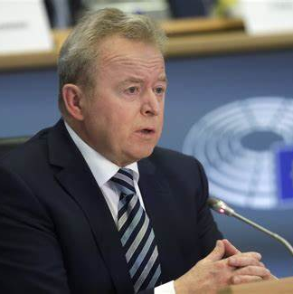
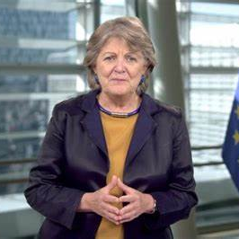
The long-term vision for EU’s rural areas
Vice-president of EC
Demography & Democracy
Dubravka Šuica
Communication from the EC
(June 2021)
Commissioner (DG AGRI)
Janusz Wojciechowski
Commissioner (DG REGIO)
Elisa Ferreira
Notes:
The EU launched a reflection with all actors across Europe to draw the common ambitions to achieve for rural areas. This process was coordinated by the vice-president Šuica (Democracy and demography), with Commissioners Wojciechowski (Agriculture and rural development) and Ferreira (Regional policy) as lead and co-lead.
The process resulted in the publication of the Communication from the EC on the long-term vision for EU's rural areas in 2021. https://eur-lex.europa.eu/legal-content/EN/TXT/?uri=CELEX%3A52021DC0345
The communication has triggered political reactions from other EU institutions such as the European Parliament, the Committee of the Regions, the Economic and Social Committee who reacted positively to the communication.
Since, there has been constructive dialogue with other EU institutions and bodies.
Three of the institutions have finalised their opinions or reports on the Long Term Vision in 2022, namely the Committee of the Regions, the Economic and social committee and the European Parliament.
The Council of the European Union is working on its conclusions on the Vision and which are expected by the end of 2023. They have not yet formalised conclusions on the vision but:
The French presidency adopted conclusions on the 8th Cohesion report that include a reference to the rural vision.
The Czech presidency has launched its national Rural pact, leading by example and participated in the declaration of Lednice that brings together also the Committee of the regions and the European Parliament.
In May 2023, the Swedish presidency hosted the Rural Pact conference in Upsala to share best practices and examples on the implementation of the Rural Pact at national level, discuss the multi-level governance for holistic rural development, explore tools and methods for the Rural Pact and examine young people’s involvement and participation in the Rural Pact
In September 2023, the Spanish presidency of the Council will organise a High-level rural policy forum event that has the ambition to prepare the ground for Council conclusions dedicated to the Rural vision.

Slide 4
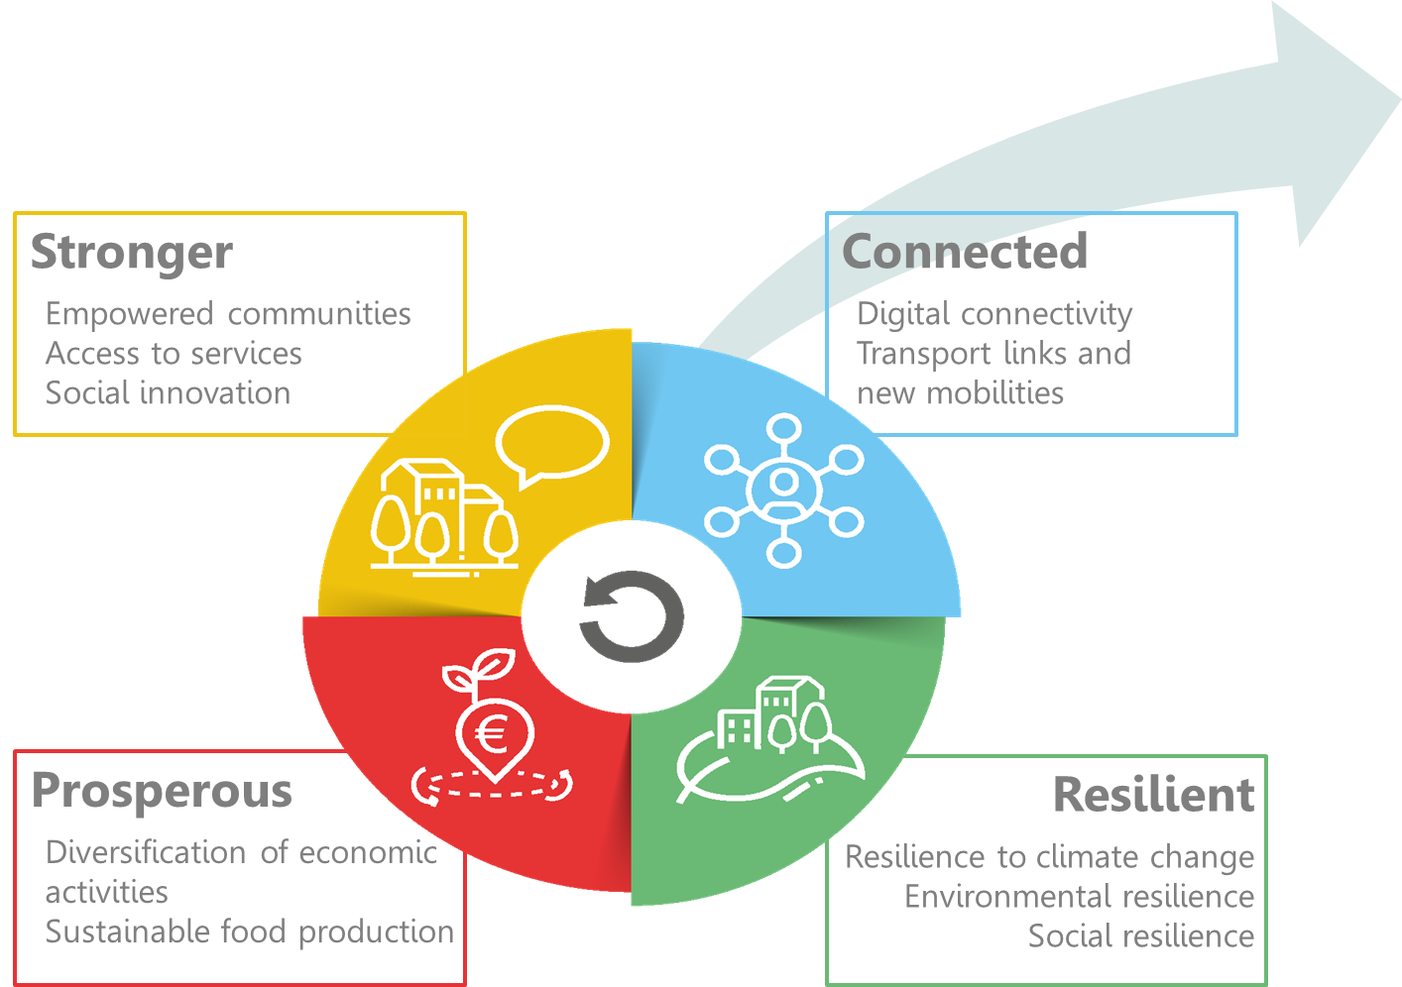
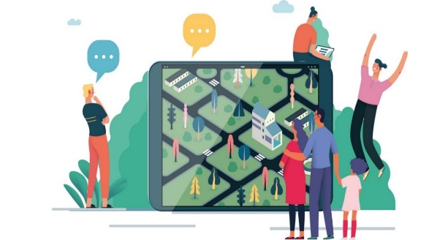
The rural vision by 2040
Shared goals for 2040
Rural action plan (EC)
&
Rural Pact (others)
Notes:
The long-term vision is a communication from the European Commission. It prepares the ground for future action but does not bring new funds. For now, stakeholders have to use existing policies and funds, as they have been agreed by the European Parliament and the Member States in the Council, before the adoption of the rural vision.
This vision brought together the common aspirations of Europeans on how they would like rural areas to be in the future: stronger, connected, resilient and prosperous.
The communication proposed two main ways to implement this vision:
The Rural action plan, which is what the European Commission proposes to do, starting from 2021.
The Rural Pact, which is about joining forces with all national, regional and local governments and stakeholders.

Slide 5
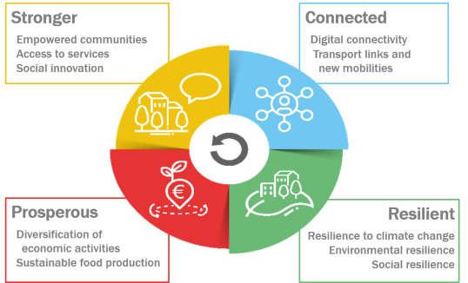
The long-term vision for the EU’s rural areas
LONG-TERM VISION FOR RURAL AREAS
10 SHARED GOALS FOR 2040
Attractive spaces, developed in harmonious territorial development
Engaged in multi-level and place-based governance
Providers of food security, economic opportunities, goods and services for wider society
Dynamic communities focusing on well-being
Inclusive communities
Flourishing sources of nature
Fully benefiting from digital innovation
Entrepreneurial, innovative and skilled people
Lively places equipped with efficient, accessible and affordable public and private services
Places of diversity
Rural action plan (EC)
&
Rural Pact (others)
Notes:
The vision set 10 shared goals to be achieved by 2040 and cover a wide variety of thematic areas.
The vision exemplifies the need to think strategically about rural areas in an integrated way to be able to respond to the needs and opportunities of rural areas.
The vision aims to address the ambitions, needs and demands from all citizens. It includes farmers and their families, other businesses and people working in rural areas (many not involved in the agri-food and forestry sectors), as well as cities and towns that find mutual benefits with rural areas.
To achieve all the goals of the vision, it is absolutely necessary to broaden the range of stakeholders involved in rural development, including public authorities and policy makers, civil society involvement, academia, citizens and businesses.
The vision.
The communication proposed two main ways to implement this vision:
The Rural action plan, which is what the European Commission proposes to do, starting from 2021.
The Rural Pact, which is about joining forces with all national, regional and local governments and stakeholders.

Slide 6
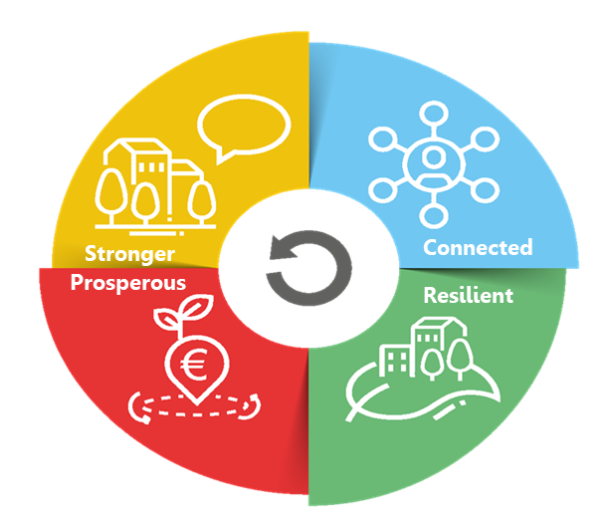
The long-term vision for the EU’s rural areas
LONG-TERM VISION FOR RURAL AREAS
10 SHARED GOALS FOR 2040
EU RURAL ACTION PLAN
9 Flagship initiatives
Rural revitalisation platform
Research and innovation for rural communities
Sustainable multimodal mobility best practices for rural areas
Rural digital futures
Support rural municipalities in energy transition and fighting climate change
Climate action in peatland through carbon farming
EU mission : a soil deal for Europe
Social resilience and women in rural areas
Entrepreneurship and social economy in rural areas
Connected
Prosperous
Resilient
Notes:
The Rural action plan contains 30 actions – 24 thematic actions and 6 horizontal actions to support implementation and improve governance.
The thematic actions are structured around the four blocks of action of the vision. They include:
9 flagships: these are bigger initiatives or groups of initiatives.
And 15 accompanying actions: these are more specific things, such as organising networking for LEADER and smart villages, or conducting specific studies.
The big novelty is that these actions involve many different Commission departments (like ministries) and the Commission organises coordination between them.

Slide 7
The rural action plan: 24 thematic actions
Rural revitalisation platform
Enabling factors, self-assessment tool
Launch 29 June 2023
Sustainable multimodal mobility best practices for rural areas
SMARTA NET Networking for municipalities
Rural municipalities in energy transition & Climate change
Rural energy communities advisory hub
Entrepreneurship and social economy
Clusters of social and ecologic innovation (rural focus) report published – study by RTD
Euroclusters call
European cluster collaboration platform
Transition pathway for proximity and social economy
Urban mobility framework published
Climate action in peatland /carbon farming
Comm “Sustainable C cycles”
3 LIFE projects
Just transition fund
CAP assessments
Certif. C removals
Research and innovation for rural communities
Horizon 2021-2024 launched (120 M€)
Startup village forum
EIP-AGRI, RIS3
Horizon 2025-2027
Rural Digital Futures
Horizon + DEP WP published
EDIH
Digital skills and jobs platform
Pilots on digital education for children in remote areas
5G for smart com.
Rural digital index
Education and youth
Study on rural young people access to ERASMUS and ESCP
Social resilience and Women in rural areas
European care strategy (2022)
EU mission: A soil deal for Europe
Calls published
Notes:
This is an image of what the European Commission have done more concretely in the past 22 months.
To quote only some highlights, thanks to various commission departments, the Commission:
is about to launch the rural revitalisation platform on 29 June 2023. This will be a collaborative platform where all of you will be able to create a profile and exchange on themes of importance, post good practices and launch thematic or country discussion groups.
have published calls for rural dedicated research and innovation projects worth 120 Million € across 2021-2024.
are working on a study to improve participation of rural young people in ERASMUS and European solidarity corps applications.
have launched the SMARTA-NET initiative, that will create networking opportunities for municipalities who want to improve rural mobility.
have launched the Rural energy communities advisory hub, which is there to support local authorities who want to take advantage of the energy transition.
have published a « rural digital index » where you can see all indicators available for rural areas on advancing towards official targets on digital policy. And they are also funding calls to improve digital connectivity.
have published the European care strategy, which calls on the Member States to improve care and education also in rural areas.
are acting for rural areas in the context of the social economy action plan.

Slide 8
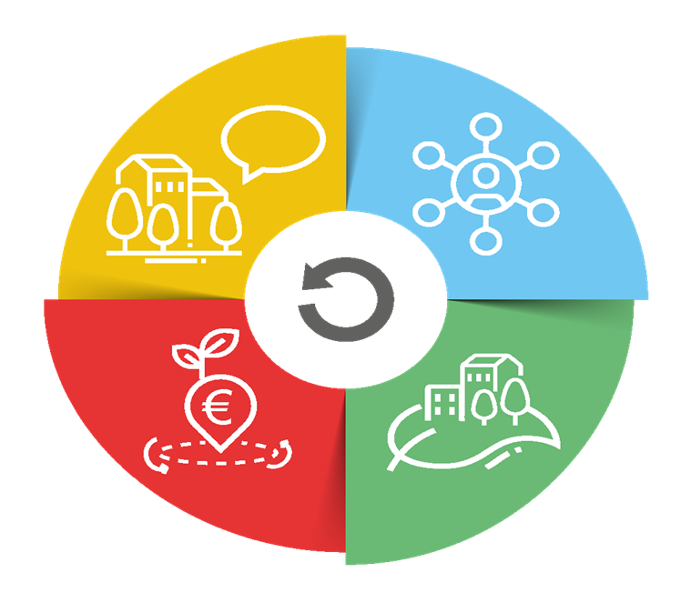
The long-term vision for the EU’s rural areas
LONG-TERM VISION FOR RURAL AREAS
10 SHARED GOALS FOR 2040
EU RURAL ACTION PLAN
6 Horizontal actions
Rural Observatory
Functional Rural Areas
Improved Statistics
Rural Proofing
Toolkit on EU funding
Rural Pact
Stronger
Connected
Prosperous
Resilient
Notes:
Similarly, all Horizontal actions are also launched.
1. (First action: the EU Rural Observatory)
First, the Rural Observatory which is coordinated by the Joint Research Center (JRC) of the European Commission. It was born with one clear ambition: give everyone access to essential data about rural areas to foster a better understanding of their circumstances and diversities, hence increasing the analytical capacities for evidence-based policies. A hundred indicators from multiple sources are included, covering economic, social and environmental dimensions at different levels of granularity. Please, browse through it if you have not done so yet.
Website: https://observatory.rural-vision.europa.eu/?lng=en&ctx=RUROBS
2. (Second action: Statistics on rural areas)
Before making them accessible in a centralised platform, data needs to be collected. To understand the complexity of the issues at stake more and better-quality data on rural areas are needed. This is why the European Commission has launched a second action, working with the statistics departments of Member States on improving statistics on rural areas. A new regulation is being discussed on population statistics, and experimental datasets on healthcare and education facilities have been published. All this to make the Rural Observatory even more comprehensive.
3. (Third action: definition of functional rural areas)
A third action is the application of the Functional Areas concept to the rural environment. Functional Areas seek to go beyond administrative boundaries through a better understanding of, population and service flows, among other things. A first methodology of Functional Rural Areas has already been published by the Commission’s Joint Research Centre and DG REGIO. Meanwhile, the Commission, and the World Bank are working on a pilot project on Functional Areas, combining cities, towns and suburbs as well as rural areas. Indeed, the rural-urban space is understood as an interlinked continuum and should not be simply opposed.
4. (Fourth action: rural proofing at EU level)
The European Commission are promoting the mainstreaming of rural areas concerns and issues — hence our fourth action, rural proofing. It is about taking a rural lens to new policy making. In November 2021, the European Commission updated the guidelines that all Commission services use to build new initiatives. Services are encouraged to explore whether initiatives will have differential impacts on territories, and if so, ensure mitigation measures. For legislatives initiatives, Territorial Impact Assessment is the procedure in place. The European Commission has also run a thematic group on rural proofing at national and regional levels, so to get to rural-proof national legislation too. All this is in full synergy with the core principle “do no harm to cohesion”.
5. (Fifth action: toolkit on EU funding)
The European Commission is also working on a toolkit oriented to practitioners on how to make full use and combine the various EU funds to support rural projects, beyond CAP and Cohesion Policy. This is planned for the end of the year, with the support of the JRC.
Attached to the toolkit is the EU territorial development, providing solutions to rural areas to make full use of the opportunities offered by Cohesion Policy itself for integrated territorial development with an emphasis on the Functional Area approach.
6. The 6th action is to propose and facilitate the Rural Pact

Slide 9
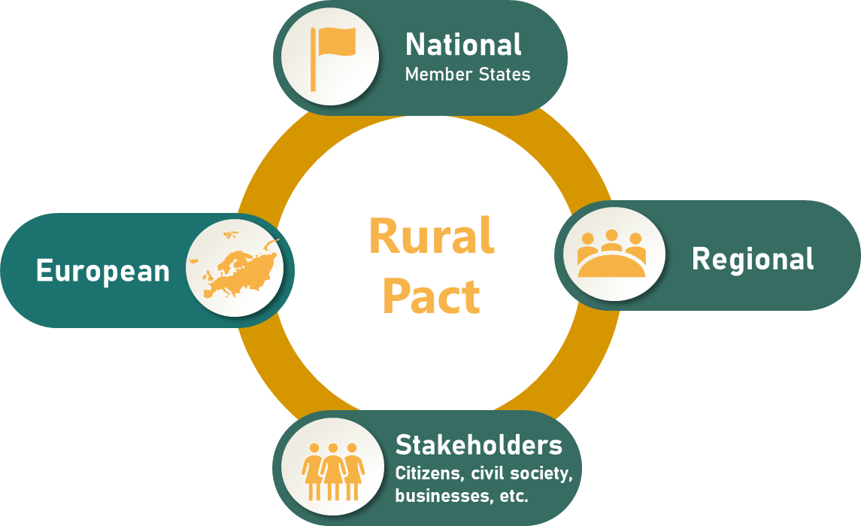
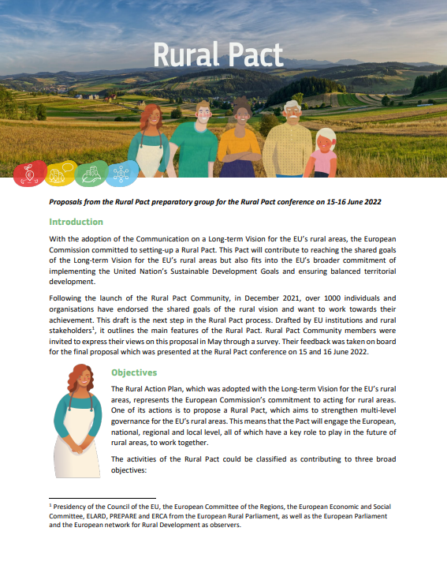
The Rural Pact
Participatory process
What is the Rural Pact ?
The Rural Pact is a formal space and framework to boost cooperation between national, regional and local governments, civil society organisations, businesses, academics and citizens to act towards the shared goals of the rural vision.
Proposal endorsed
Rural Pact Conference (15-16 June 2022)
Notes:
The European Commission set up the Rural Pact in December 2021, together with the Rural Pact community. It has then worked with the community and a Rural Pact preparatory group and come up with a proposal that was endorsed at the Rural Pact Conference on 15-16 June 2022.
The Rural Pact is a formal space and framework to boost cooperation between national, regional and local governments, civil society organisations, businesses, academics and citizens to act towards the shared goals of the Vision.
It is this diverse community that will seize this opportunity for a European rural agora for discussion and interaction. The Rural Pact belongs to all actors willing to make the difference in EU’s rural areas and aims to act as a network for governance of rural issues, complementing the Commission Rural Action Plan, amplifying rural voices and giving them direct access to EU level.

Slide 10
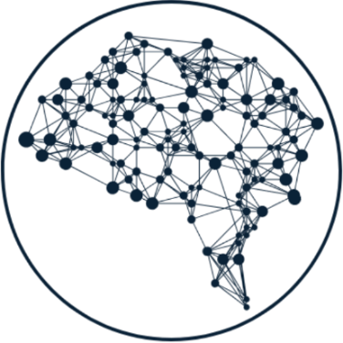
The Rural Pact - Objectives
Amplify the voice of rural areas and bring them up in policy agendas
Networking, collaboration & mutual learning
Commitments to act
Join the Rural Pact Community! https://ec.europa.eu/eusurvey/runner/RuralPact
Rural Pact Proposal: https://agriculture.ec.europa.eu/system/files/2022-07/rural-pact-proposal_en.pdf
Notes:
The Rural Pact has three objectives:
Amplify rural voices by bringing up key rural concerns in the policy agendas and make these voices acted upon.
Networking, Collaboration & mutual learning
Commitments to act. These are specific actions that individuals and organisations submit to the Rural Pact and that they commit to implement to contribute to achieve the rural vision. For instance: A rural municipality has committed to implement a Renewable energy community to support the green transition of the area, involving and mobilising 200 citizens and businesses.

Slide 11
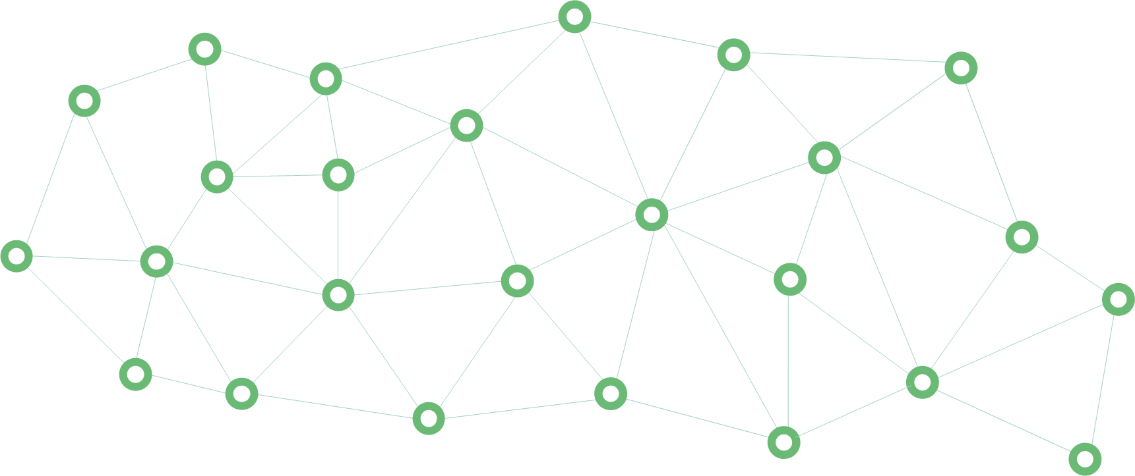
The Rural Pact Community Members
+1750
Rural Pact Community Members by May 2023
Public authorities
Businesses
Academic and R&I
+80
Commitments to act
Civil Society
Individuals
Participating in the Pact = Committing to act for one or more of its objectives
Join the Rural Pact Community! https://ec.europa.eu/eusurvey/runner/RuralPact
Notes:
There are five types of participants in the Rural pact which are : public authorities, civil society organizations, businesses, citizens, as well as academic research bodies. These categories encompass everyone involved in rural development.
It is important that all stakeholders register as members of the Rural Pact community in order to participate: Join the Rural Pact Community! https://ec.europa.eu/eusurvey/runner/RuralPact

Slide 12
Rural Pact Support Office
The Rural Pact
Rural Pact Coordination Group
Rural Pact Support Office
Informal group steering the Rural Pact process
Three-year mandate
Learn more here
Provide facilitation services to the Rural Pact community
Networking and information
Build synergies with networks and governing bodies
Evaluate needs of the RP community and support its work
Notes:
How the Rural Pact is being coordinated ?
- On the one hand, the Rural Pact Support Office (RPSO) coordinates and implements the networking activities of the Rural Pact and its community with the ambition to achieve the Rural Pact objectives and the Long-term vision for EU’s rural areas. The RPSO builds synergies and complementarities with all relevant EU policy networks and initiatives working on and for rural development to jointly contribute to stronger, connected, prosperous and resilient rural areas in Europe, including the CAP Network, Broadband Competence Office Support Facility, Territorial Agenda 2030, Preparatory Action Smart Rural 21 & 27, or with the Talent Booster Mechanism.
On the other hand, a Rural Pact Coordination Group, representative of the participants of the Pact, is set up. This is a special group of the European Commission which steers the Rural Pact process with a 3-year mandate. The lead DG is DG Agriculture and Rural Development, and the co-lead DG is DG Regional and Urban Policy. The Rural Pact Coordination Group will overlook the RPSO tasks and will be able to give strategic orientations by making proposals to the European Commission.
The RPSO and the Rural Pact Coordination Group will meet twice a year, including one in-person meeting and one on-line meeting.

Slide 13
The Rural Pact Support Office
Good Practices
Policy Action Labs Policy Forums
Animation Networking
Good Practice Webinars
Rural Pact
Support Office
Website & Social Media
RP Coordination Group
Magazine, Newsletters
Commitments to act
Notes:
The Rural Pact Support Office
The Rural Pact Support Office (RPSO) coordinates and implements the networking activities of the Rural Pact and its community with the ambition to achieve the Rural Pact objectives and the Long-term vision for EU’s rural areas. The RPSO is tasked for the next years to:
animate the members of the community as well as encourage and promote commitments to act; the RPSO is responsible for ensuring that the Rural Pact community is engaged and makes commitments to fulfil the ambitions set out in the LTVRA. The RPSO will interact with stakeholders who committed to the Rural Pact to evaluate their needs and accompany them as well to attract new members.
identify and promote good practices that can inspire action in rural areas;
organise webinars for capacity building and peer learning, as well as high-level policy events;
support the meetings of the Rural Pact Coordination Group;
keep the community informed through the website, social media channels, the monthly newsletter and the annual Magazine.

Slide 14
Main Events in 2023
Policy Labs
Good Practice Webinars
Taking action to tackle rural depopulation, Brussels, Belgium (29 June)
Online - Designing future support for rural areas (December – tbc)
Fostering social entrepreneurship in rural areas through local action (11 May)
Strengthening digital skills of rural people to benefit from the digital era (8 June)
Energy transition (October – tbc)
Webinar 4: topic to be defined (December – tbc)
https://rural-vision.europa.eu/events_en
Notes:
Find out information about the main events organised in 2023. Last update 12 May 2023.

Slide 15
Main Events in 2023
High level Policy Forum
Shaping the future of rural areas
(27-29 September), Sigüenza (Spain)
Organised by Spanish presidency & European Commission
https://rural-vision.europa.eu/events/shaping-future-rural-areas-2023-09-27_en
Notes:
This slide introduces the main events in 2023. Last update 12 May 2023.

Slide 16
Be informed, participate and take action
Steps
1
Join the Rural Pact Community
Form: https://ec.europa.eu/eusurvey/runner/RuralPact
2
Take action contributing to the vision & share it with us
Form: https://ec.europa.eu/eusurvey/runner/TheRuralPactCommitmentCanvas
Notes:
Steps to become a member of the Rural Pact.
Join as a member of the Rural Pact Community by filling the dedicate Form: https://ec.europa.eu/eusurvey/runner/RuralPact
Make a commitment to implement a concrete action, project, initiative that contributes to the Rural Pact and share it with us by filling the following Form: https://ec.europa.eu/eusurvey/runner/TheRuralPactCommitmentCanvas

Slide 17
THANK YOU
Notes:
Thank you!

